Slide 1
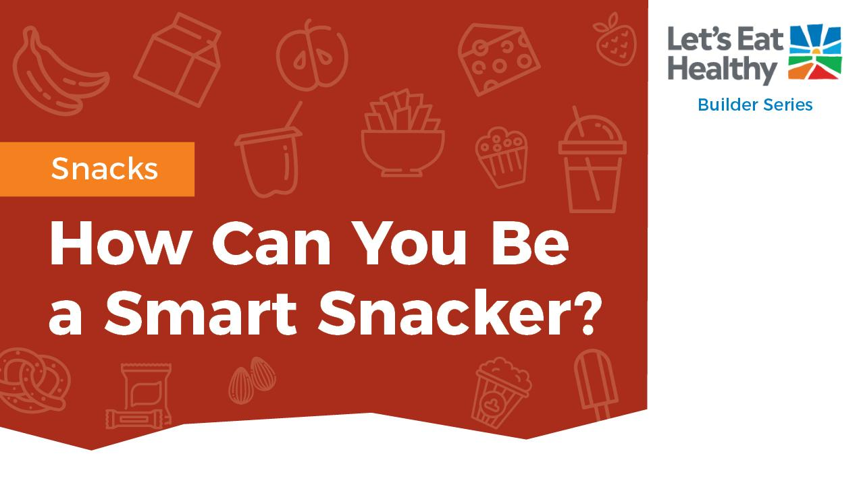

Educator Guide

Slide 2
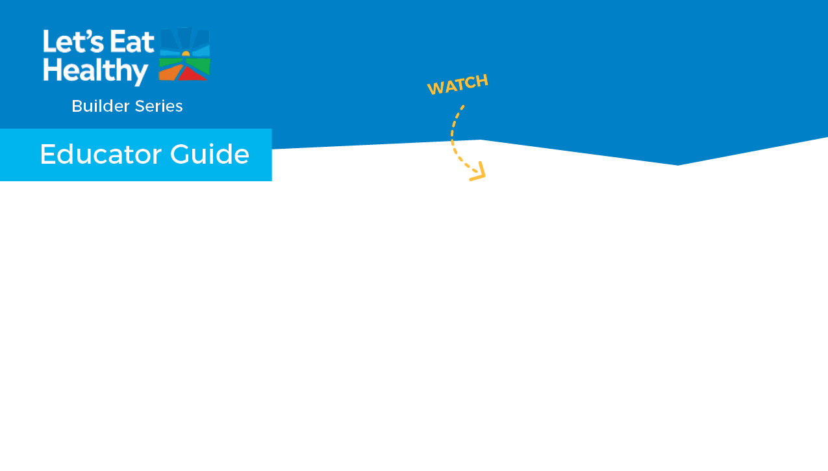
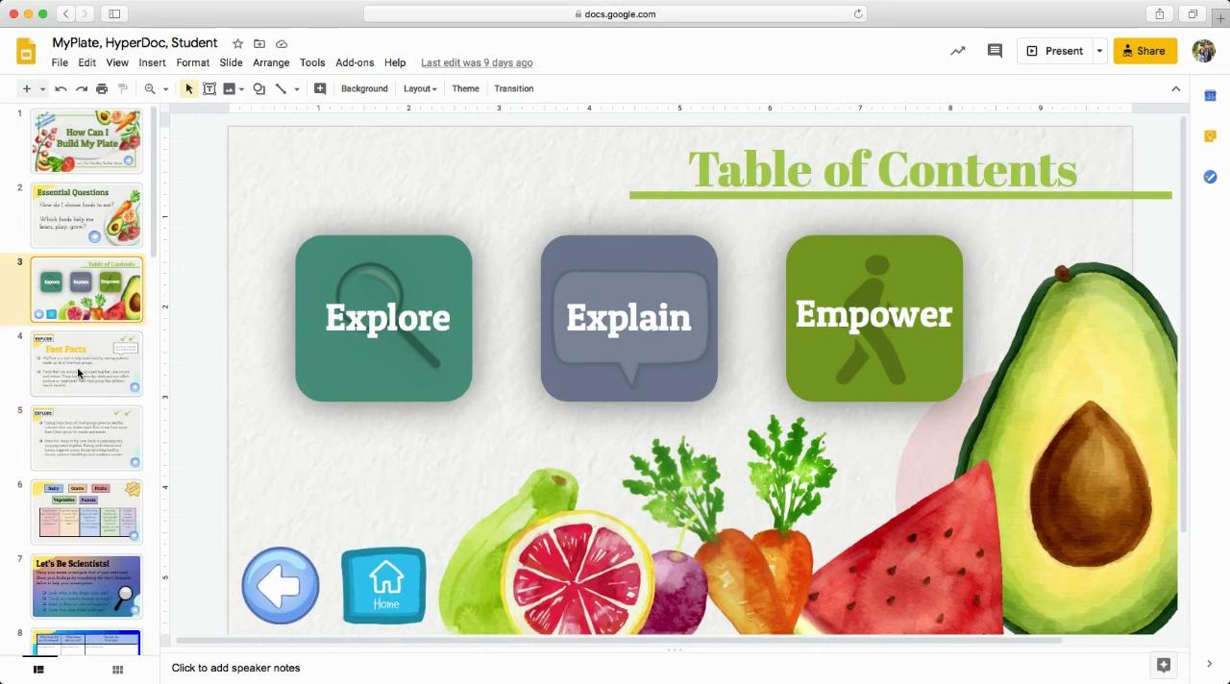

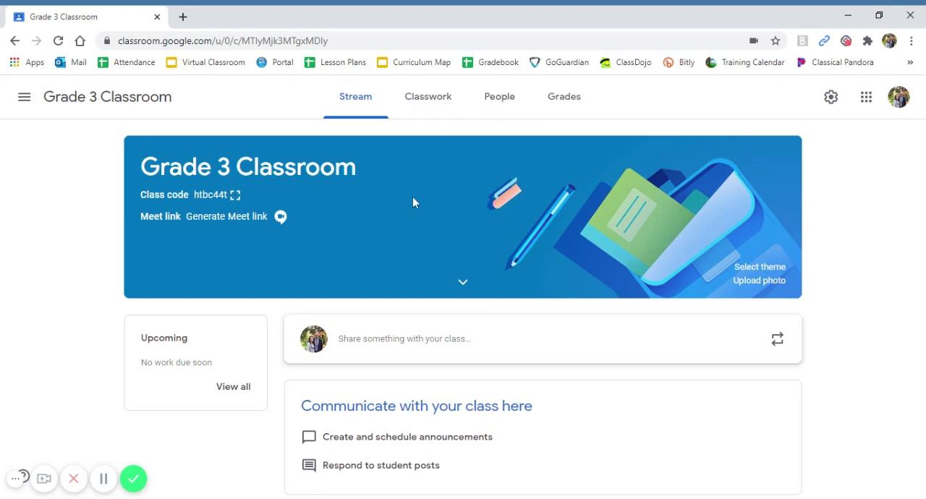


Navigating Digital Google Slides
Using HyperDoc:
You are using the Educator Guide, which includes notes and instructional videos.
Watch these 2 videos as an introduction to using the Builder Series.
The Builder Series is an interactive HyperDoc that includes aligned standards, facts, and slides labeled “Educator Guide” that are hidden from student view when presenting this material.
To make hidden slides viewable, simply select the slides, right click, and deselect Skip Slide.
Adding HyperDoc to Google Classroom:

Slide 3
Section | Supported Standards CCSS-ELA | Rationale | RFM* CCSS – ELA | Supported Standards Health | Rationale | RFM* Health | Supported standards PE | Rationale
Explore | CCSS.ELA- LITERACY .RI.3.7 | Use information gained from illustrations (e.g., maps, photographs) and the words in a text to demonstrate understanding of the text | Brainstorm Breakfast foods with students. Compile list of foods they believe to be “healthy and unhealthy.” This will help with creating a breakfast plan
Explain | CCSS.ELA- LITERACY .RI.3.1 | Ask and answer questions to demonstrate understanding of a text, referring explicitly to the text as the basis for the answers. | remind students of how to properly create or build a breakfast. Choosing foods from at least three food groups.
Apply |  |  |  | 6.1.P | Set a short-term goal for positive health practices
Physical Activity |  |  |  | Grade 4: 1.3.N, 1.6.N, 5.1.N, 5.2.N, 7.1.N, 7.2.N, 7.4.N Grade 5: 1.3.N, 1.6.N, 1.8.N, 5.1.N, 5.2.N, 7.1.N |  |  | Grade 3: 3.3, 3.4, 3.7, 4.8 Grade 4: 3.3, 3.7, 4.4 Grade 5: 3.2, 3.3, 3.7

Slide 4
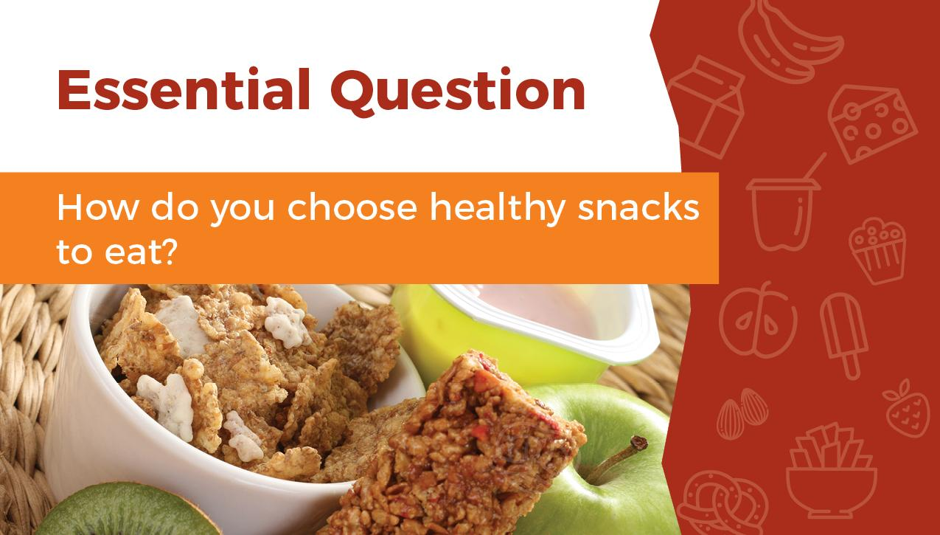

Slide 5
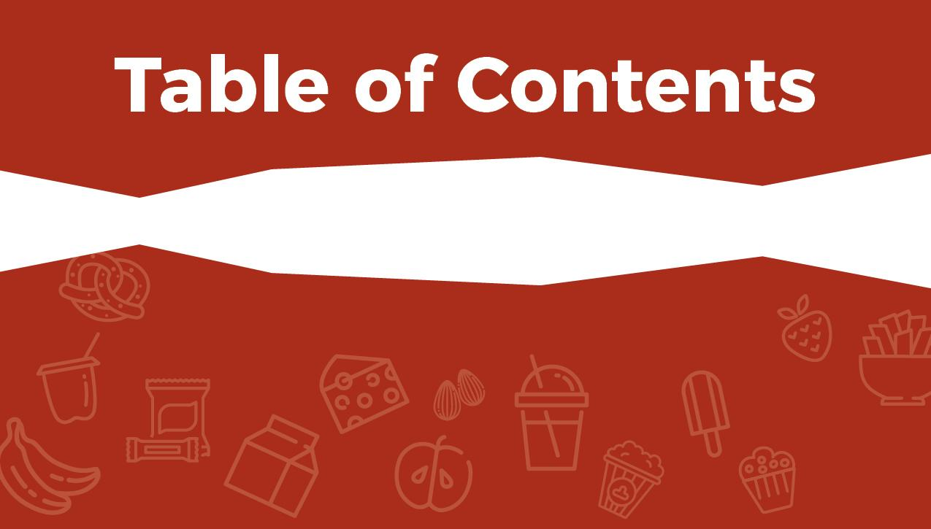

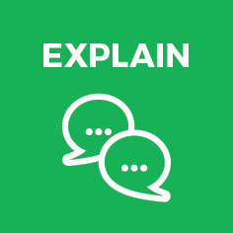



Slide 6
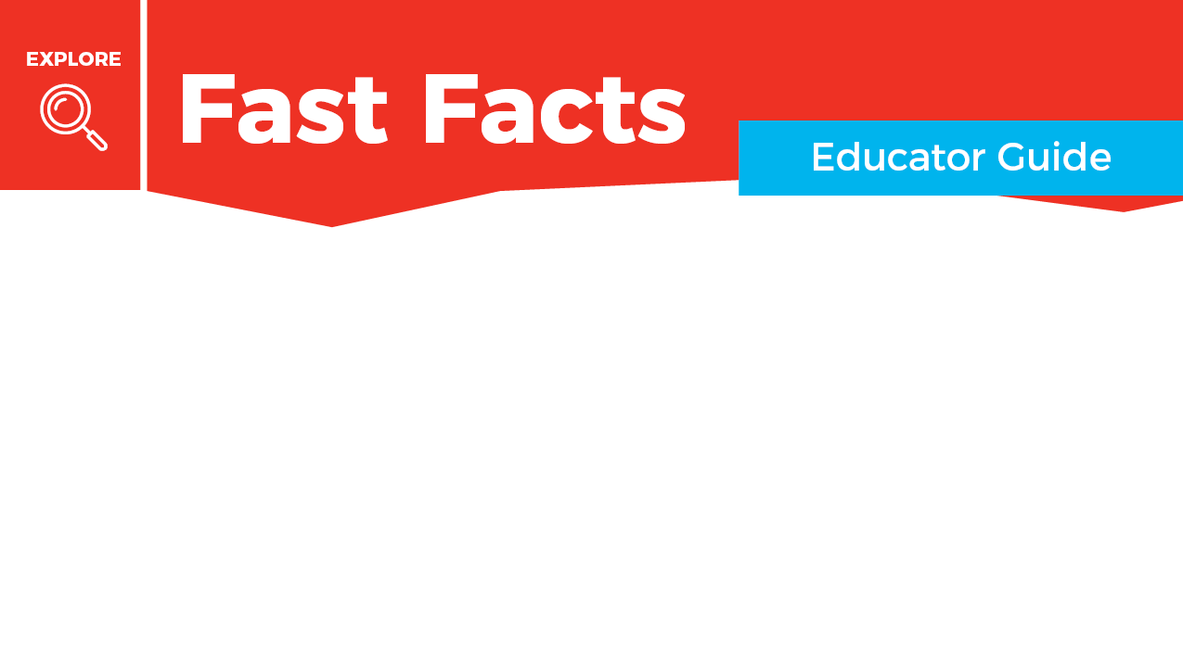
Snacks are important for children because they burn energy quickly. Snacks, or “mini meals” can provide nutrients and energy throughout the day when children are active.
A healthy snack is built from the food groups. Try to combine foods from at least two different food groups. An example could be a granola bar and fresh fruit or vegetables. Balance is important for snacks, and they should incorporate several food groups as well as foods that children enjoy.

Slide 7
Foods high in sugar, salt, or fat like chips, soft drinks, and cookies can be enjoyed occasionally but should be limited. These foods provide an excess of calories and not many nutrients.
Serving and storing healthy snacks consistently can help children feel empowered to make and eat nutritious snacks. Having them at predictable times of day and stored in a consistent place helps them be a part of choosing to eat healthy snacks. You can also let them help shop for their snack foods.

Slide 8
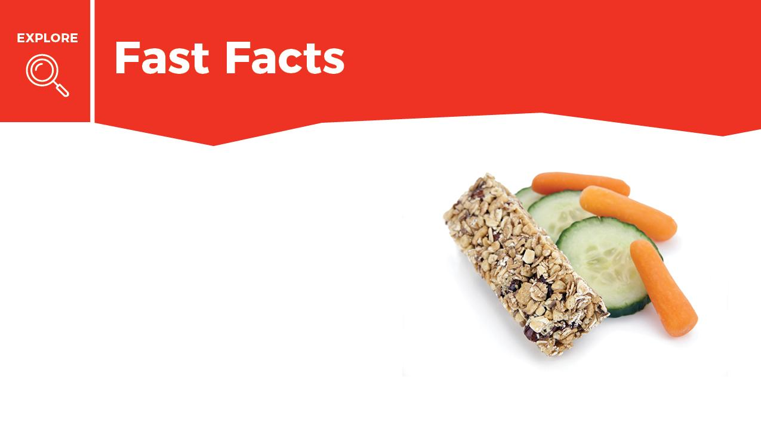



Mark done in the box when finished reading.
Snacks are like mini meals that can help fuel your body throughout the day.
A healthy snack has foods from at least 2 of the 5 food groups. For example, a granola bar and fresh fruit or vegetables includes foods from the Grains group and the Fruits or Vegetables group.

Slide 9
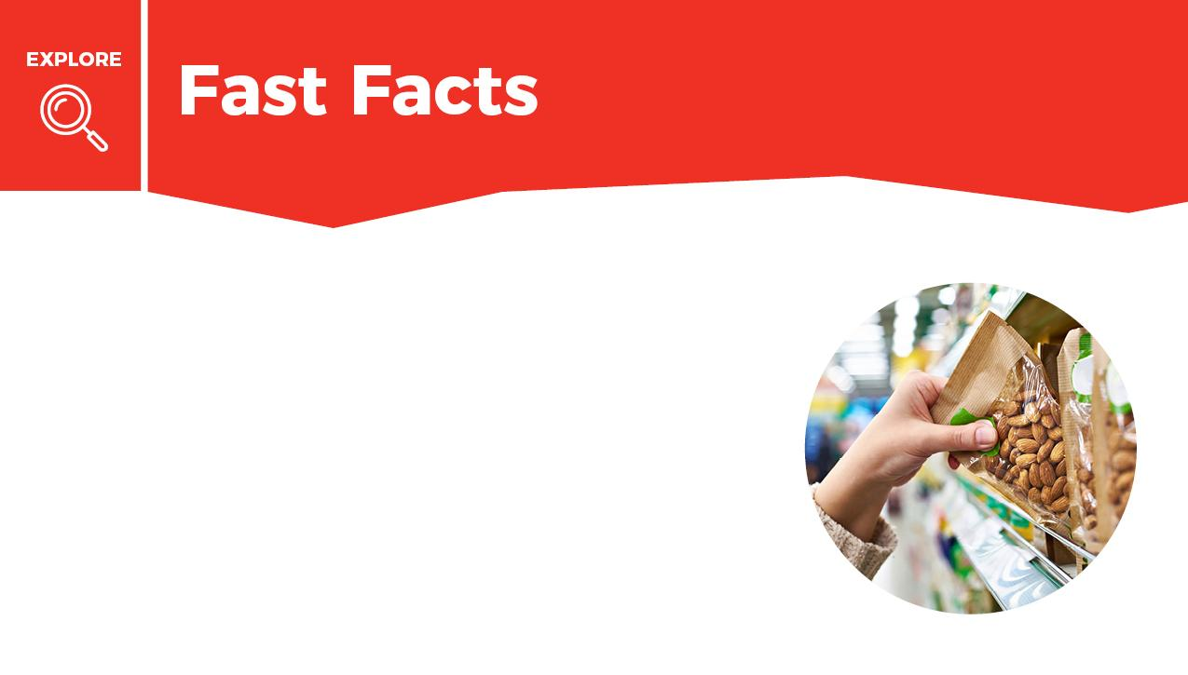
Mark done in the box when finished reading.
Cookies and chips are high in salt, sugar, and fat. Instead, reach for foods from the food groups as a healthy snack choice.
You can help shop for healthy snacks. Talk to your parents about making healthy snack choices together.

Slide 10

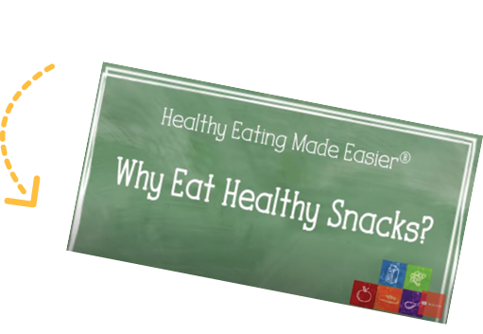
Snacks are mini meals that give you energy and help you learn, play, and grow. Explore how snacks from the food groups help you stay focused and fill you up between meals by following the link to watch the Why Eat Healthy Snacks video.

Slide 11
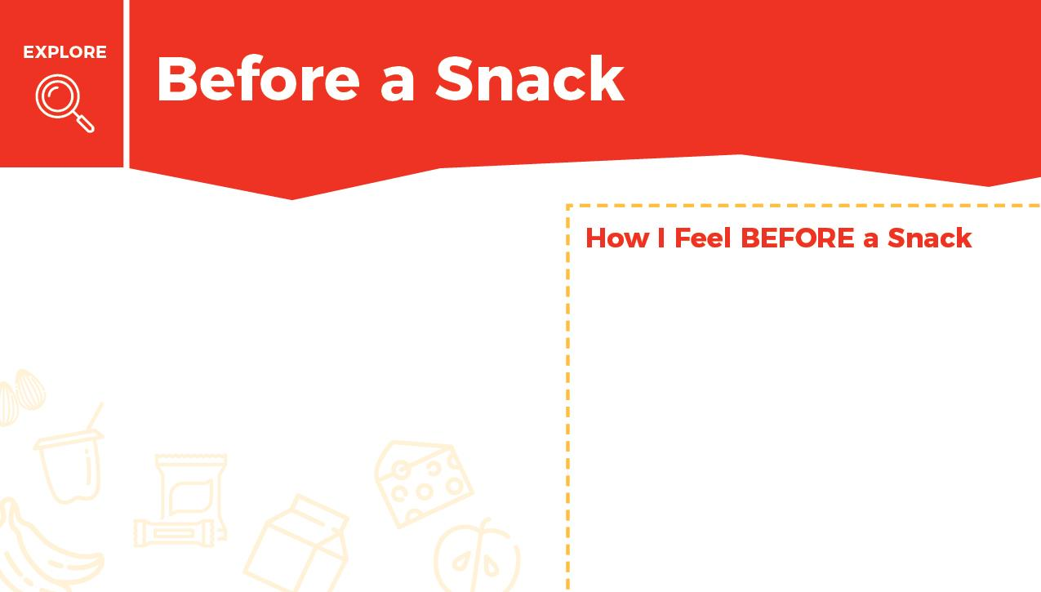

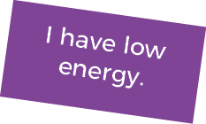


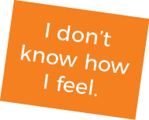
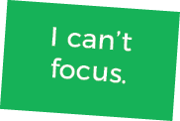
How do you feel BEFORE you eat a snack?
Drag your choices to the box on the right.
When you are finished put a check mark in the box.

Slide 12
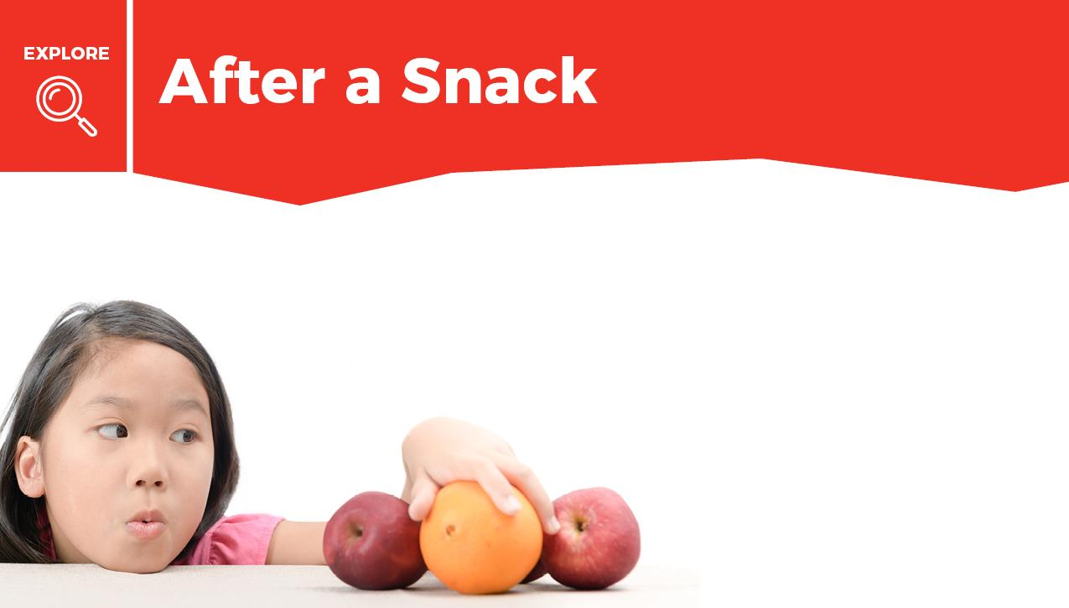
Think about your snack choices, what you chose either today or yesterday. On the next slide, fill in what you ate and how you felt after you ate your snack.

Slide 13
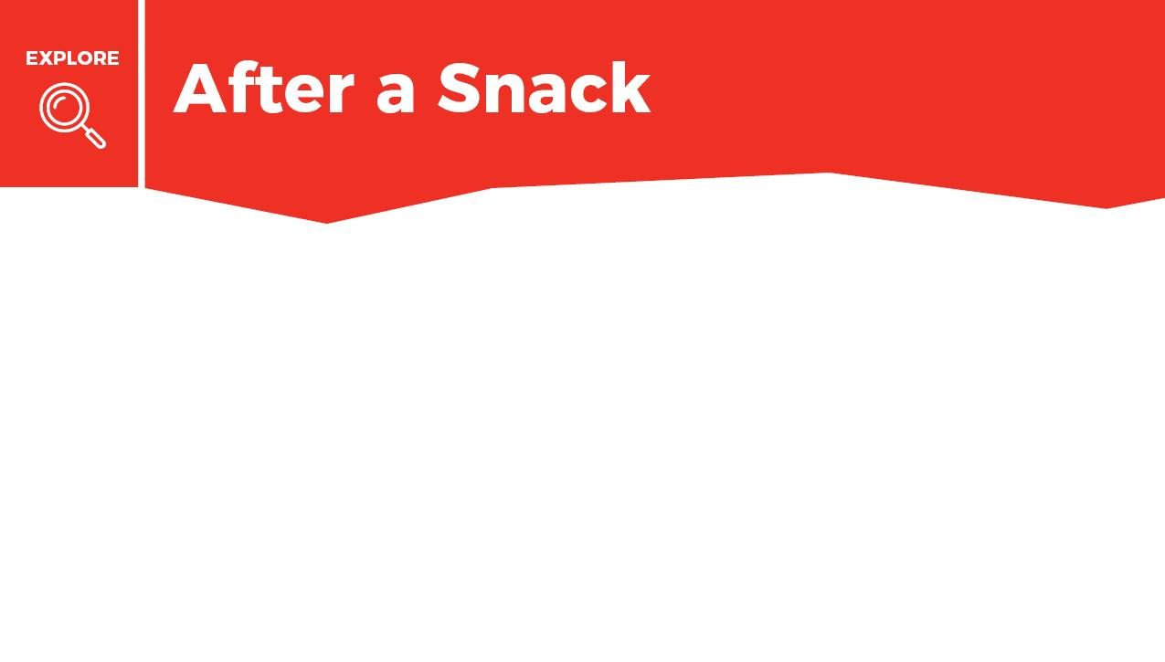




Drag an emoji that shows how you felt after eating your snack.
Type your answer into the boxes.
What did you eat? | When did you eat it? | Where did you eat it? | How did you feel after eating it

Slide 14
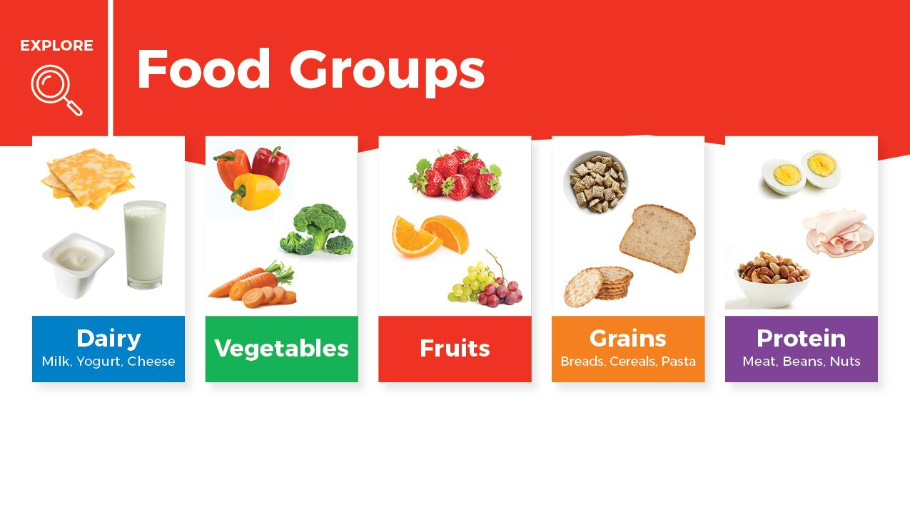
A smart snack has 2 or more food groups in it. A mix of food groups gives your body the most health benefits.

Slide 15
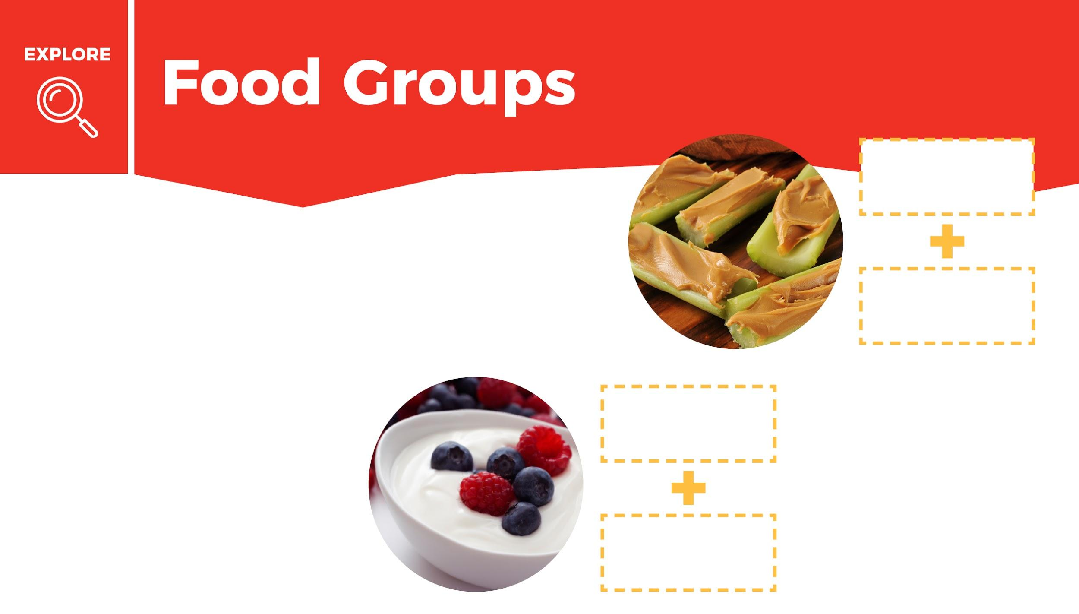





Celery and
peanut butter
Look at the pictures of the snacks. Pick 2 food groups that are in the snack. Drag and drop the food groups next to the pictures. When you are finished put a check mark in the box.
Yogurt and
berries

Slide 16
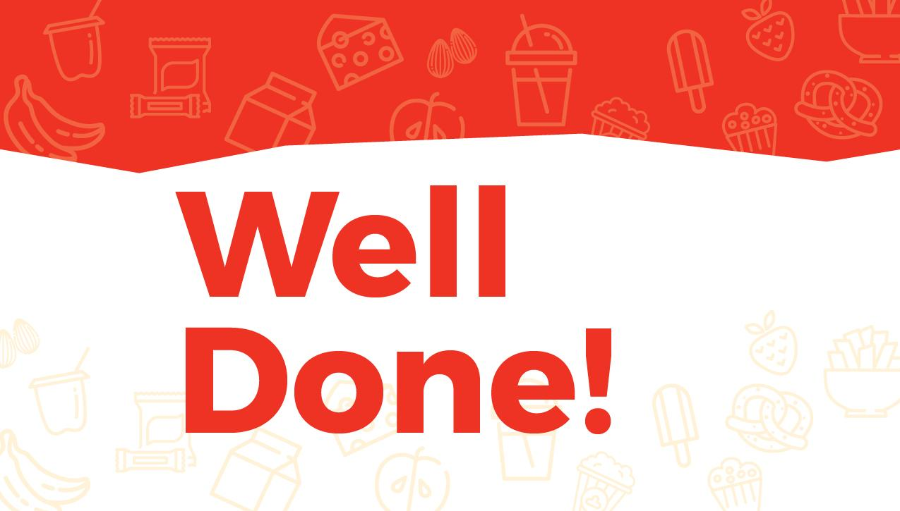

Slide 17
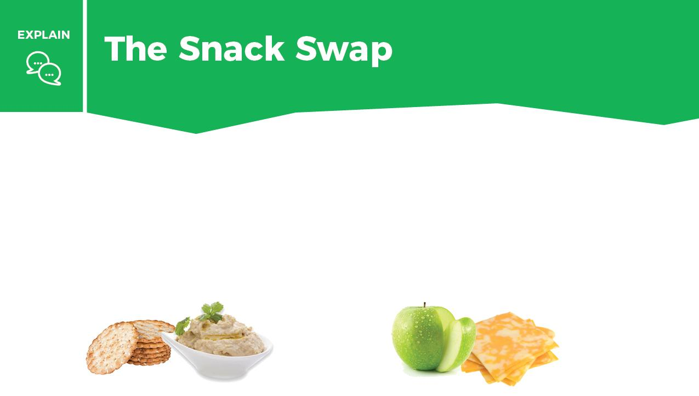
Snacks are mini meals. A complete snack has 2 of the 5 food groups (for example, whole-grain crackers and hummus or apple slices and cheddar cheese).
Packaged snacks like chips and candy can give quick energy but will make you tired quickly, too. Healthy snacks give you an extra boost of long-lasting energy to help you learn, play, and grow.

Slide 18
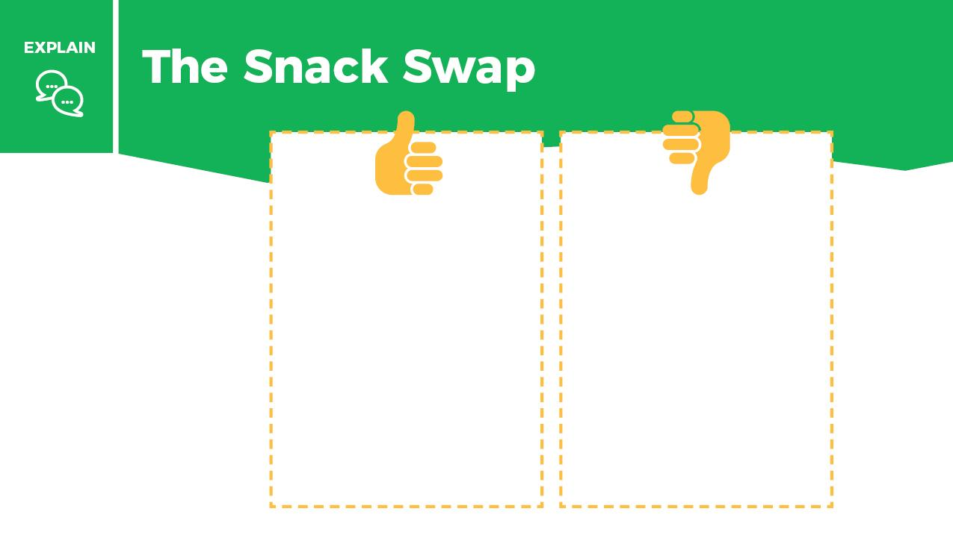


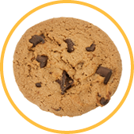
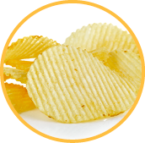
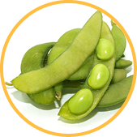
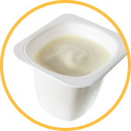
Instructions
Move foods from the food groups to the thumbs-up box.
Then move the remaining foods to the thumbs-down box.
When you are finished put a check mark in the box.

Slide 19
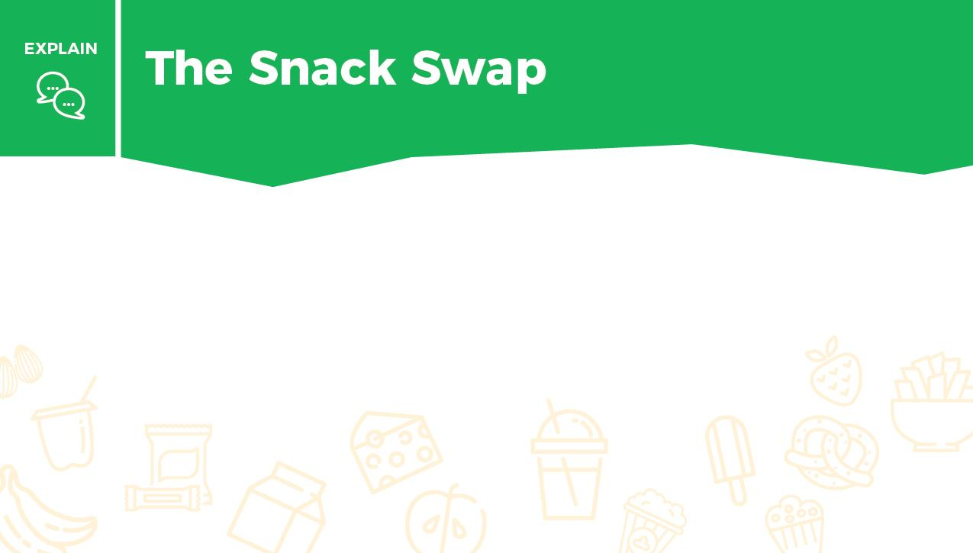
How do you decide which snacks to eat?
Write what you learned about smart snacking in the box.

Slide 20


Slide 21
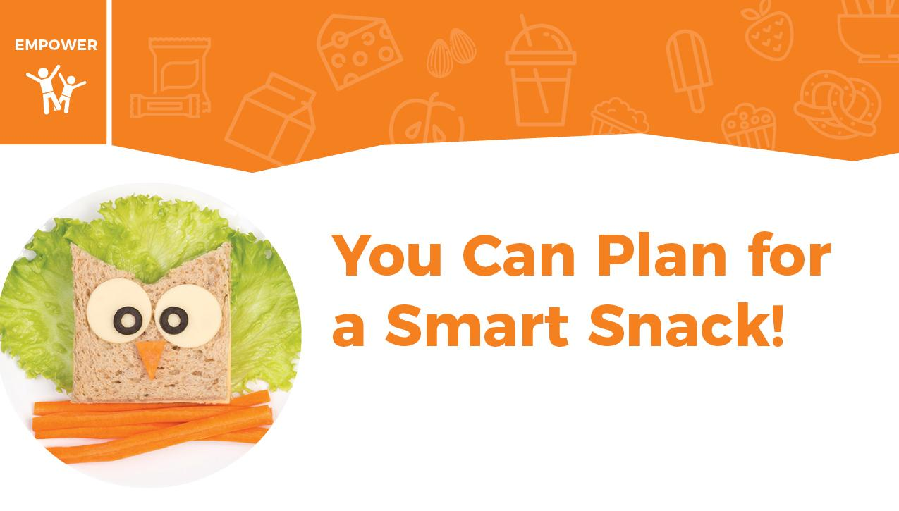

Slide 22
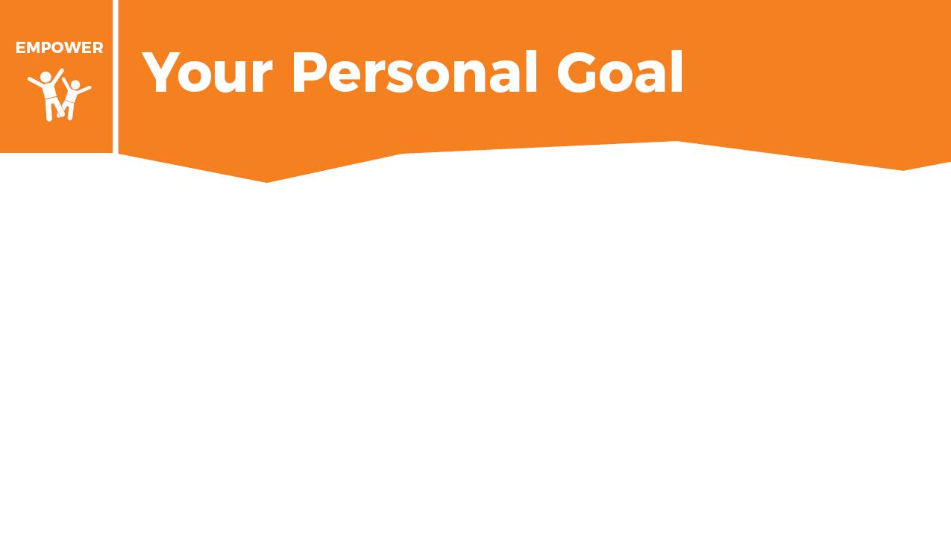
Fill in why
I will eat a snack because it helps me .
My favorite healthy snack combines these 2 foods:
and . I will eat a smart snack at
.
Fill in food
Fill in food
Fill in where
Fill in when

Slide 23
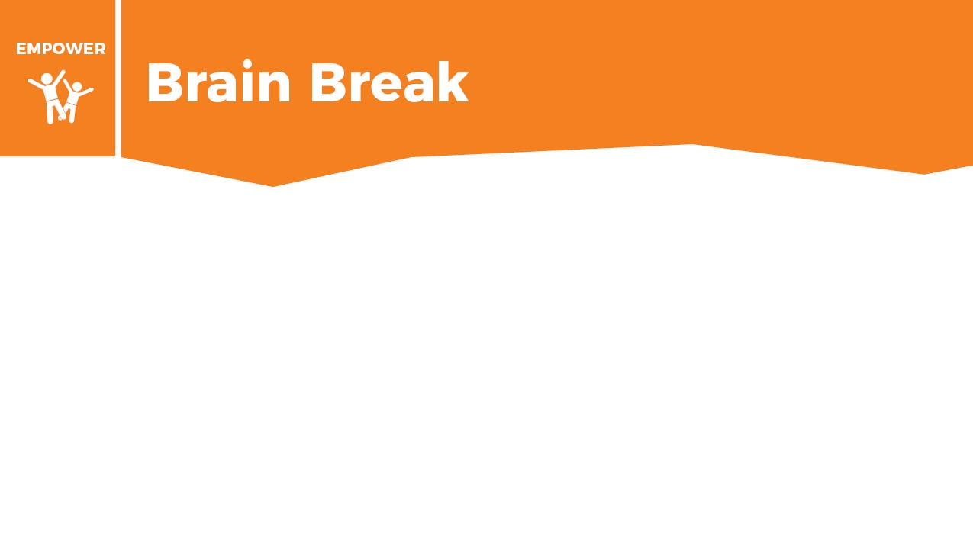


STEP 1: Perform the following circuit as many times as you can in 2 minutes and record how many you completed:
5 squats
5 squat jumps
5 jumping jacks
STEP 2: Rest for 5 minutes.
STEP 3: Now run in place as fast as you can for 1 minute without stopping.
STEP 4: Repeat Step 1 for 2 minutes and record how many you completed.
STEP 5: Compare your results.
Number completed
Number completed

Slide 24
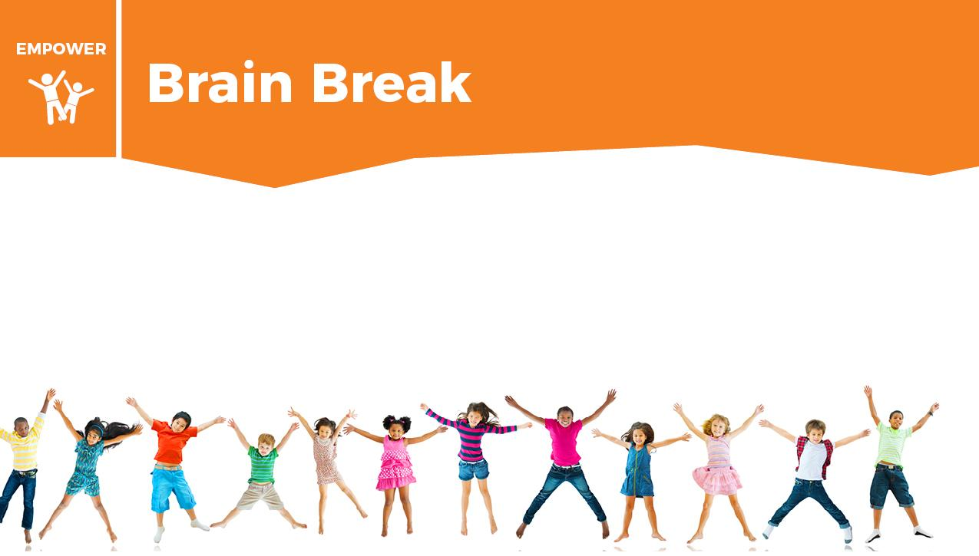
The first 2 minutes were easier than the second. You had more energy the first time since you did not run in place to start. This is similar to choosing snacks. Snacks from the food groups will give you energy that lasts a long time, while foods high in sugar, salt, and fat will give you quick energy but leave you feeling tired shortly afterward.

Slide 25


Slide 26
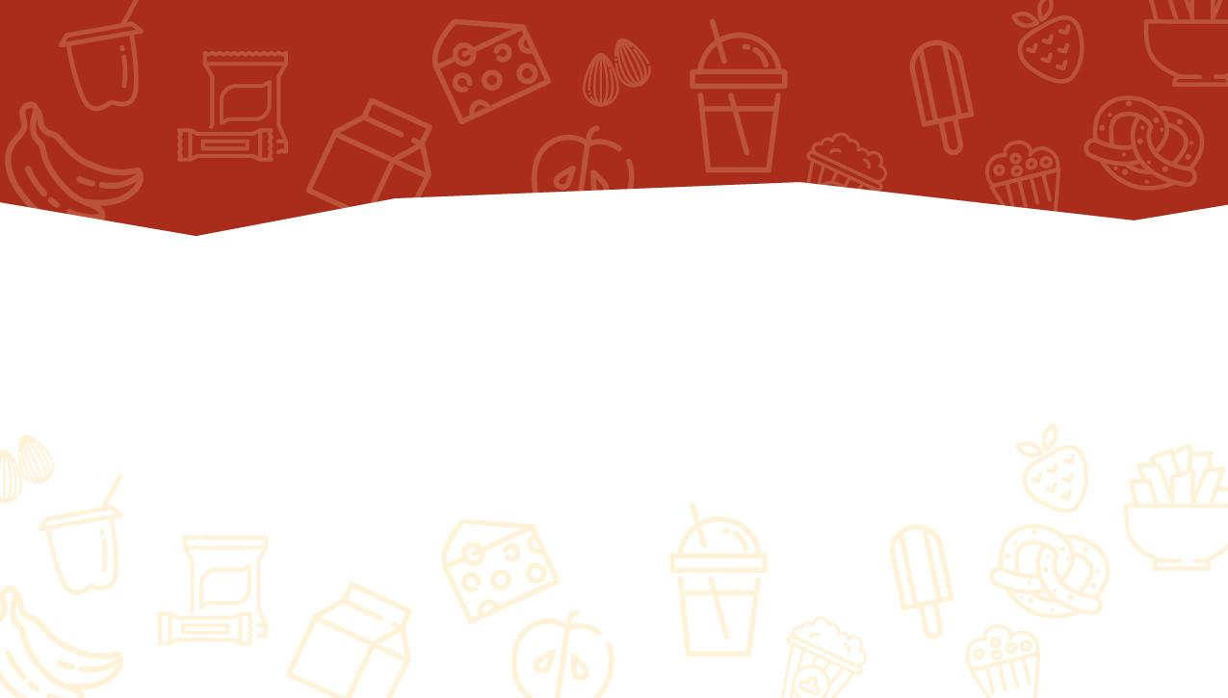
Please follow this link to a short survey to provide your feedback.
Encourage students to complete the short Knowledge Check after completing the Builder.

