Slide 1
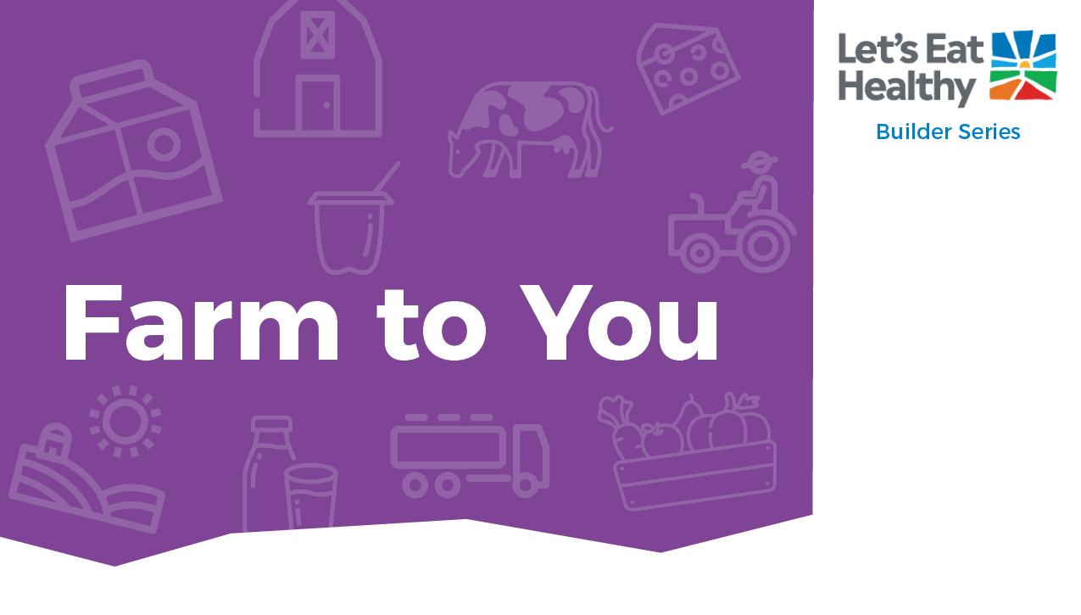


Slide 2
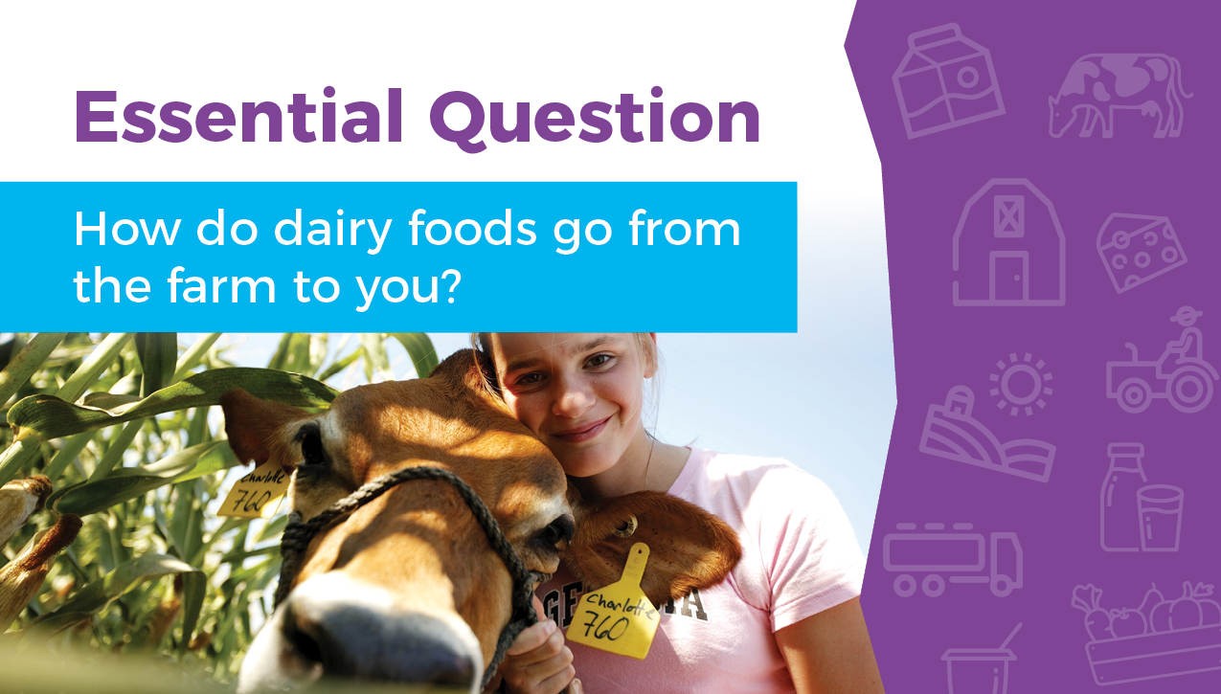

Slide 3
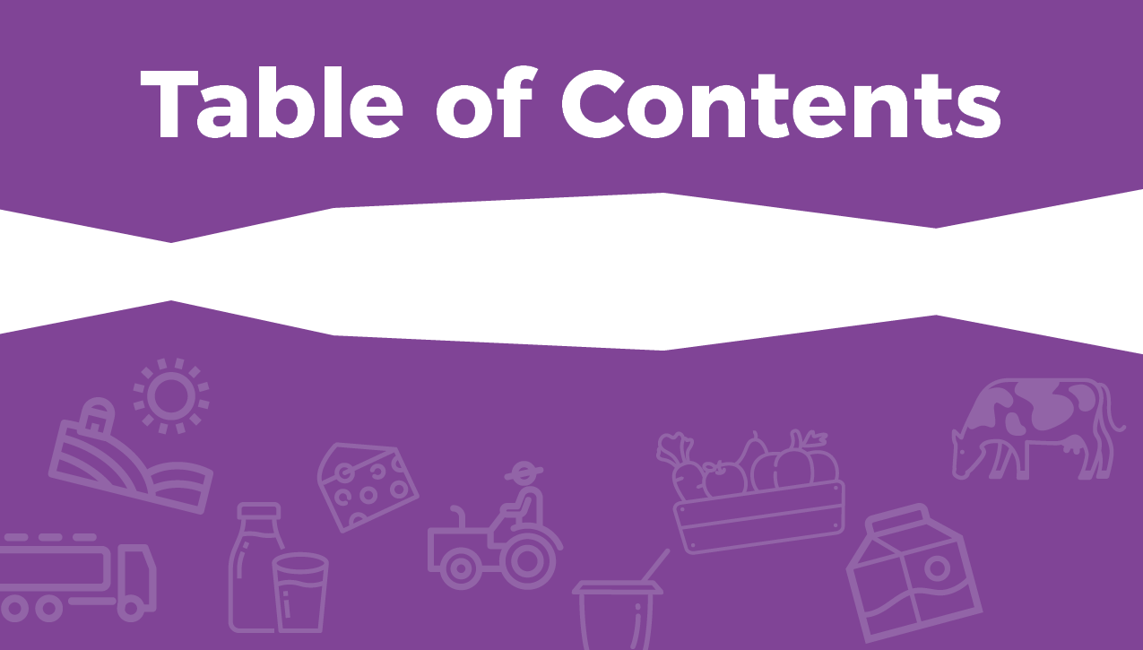





Slide 4
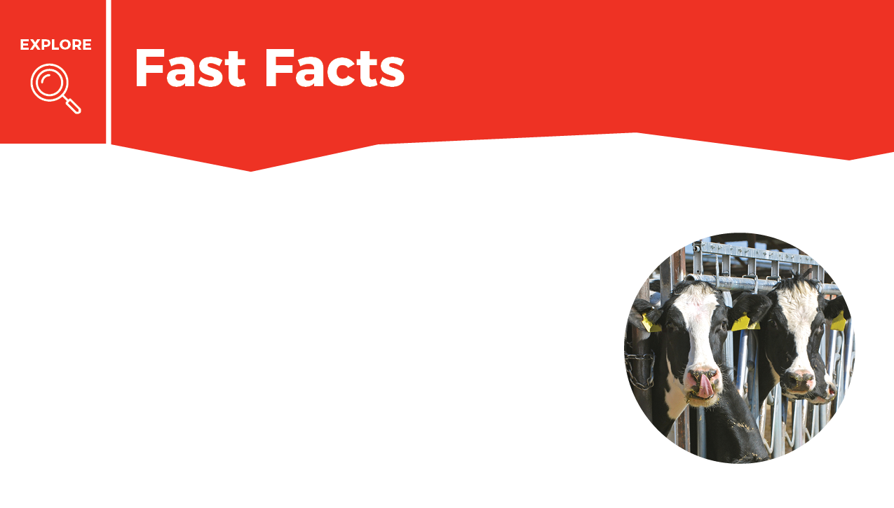



Mark done in the box when finished reading.
California produces much of the country’s food, including nearly 20% of the nation’s supply of milk.
The dairy industry plays an important role in California’s economy.
The food system includes all steps from farm to you: producing, processing, storing, transporting, purchasing, and preparing food.

Slide 5

Mark done in the box when finished reading.
People access food from sources such as farms, community and home gardens, farmers markets, produce stands, grocery stores, restaurants, and school cafeterias.
Dairy farmers care for their animals by providing food, water, shelter, and veterinary care. Farmers also care about their local communities by recycling on the farm, reusing waste products, and reducing their environmental footprint.

Slide 6
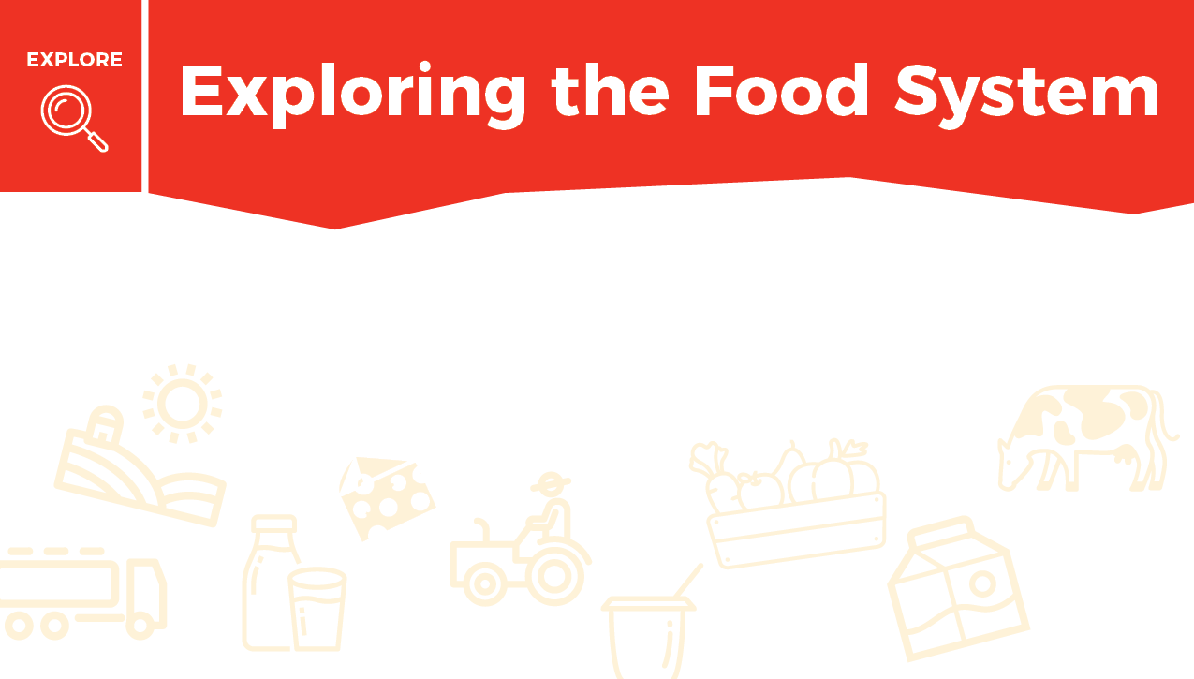


Follow the path your dairy foods take from the farm to your own refrigerator.
Notice all of the steps taken to make sure your milk and dairy foods are safe and fresh.

Slide 7
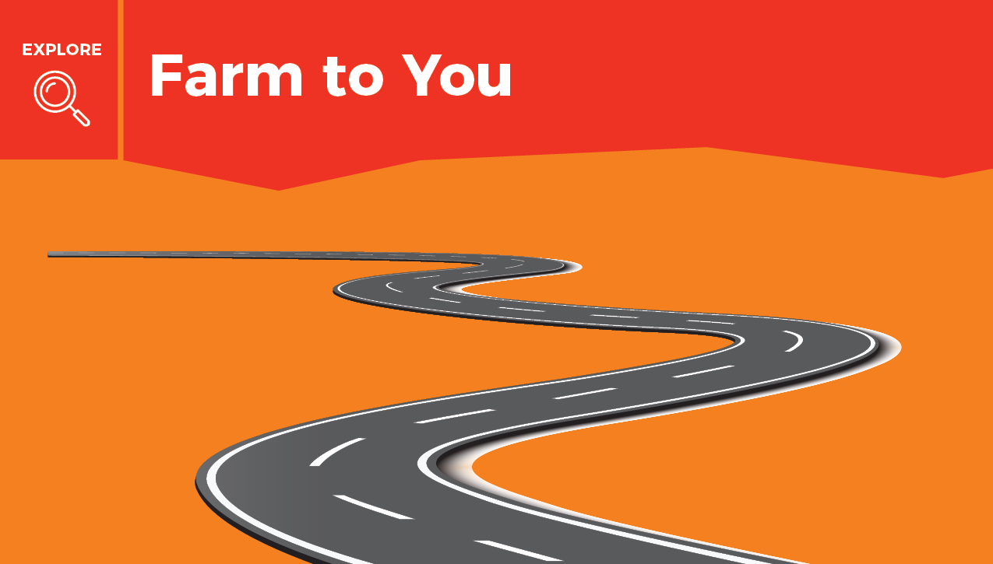
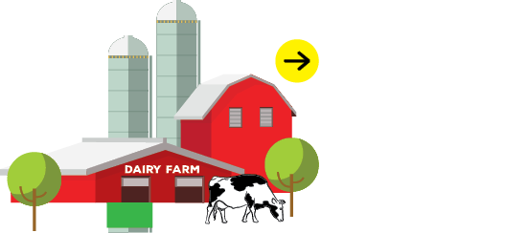
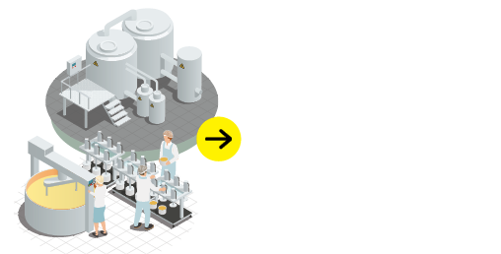
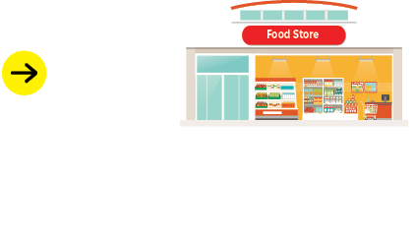

Click on the different places to learn more!

Slide 8
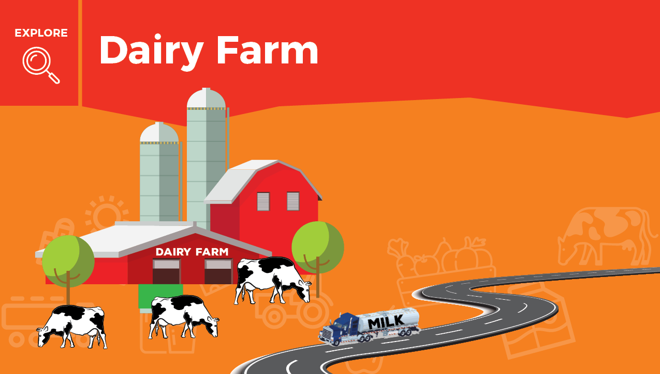


Milk comes from dairy farms where farmers take care of their cows.
Milk is tested for quality then travels in a refrigerated truck from the farm to a creamery.

Slide 9
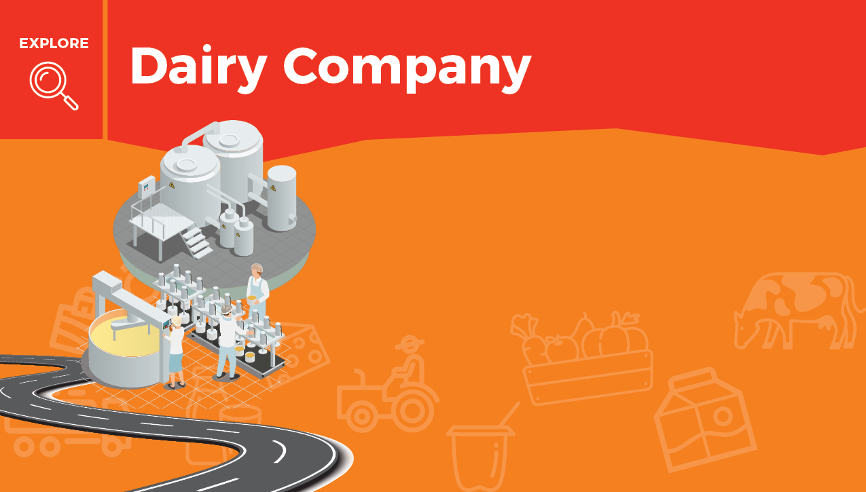



Milk is pasteurized—heated up then cooled quickly—to destroy any germs and make it safe to drink.
Milk is homogenized or mixed up to make it smooth and creamy.
Milk is put into cartons or made into other dairy foods such as yogurt and cheese.

Slide 10
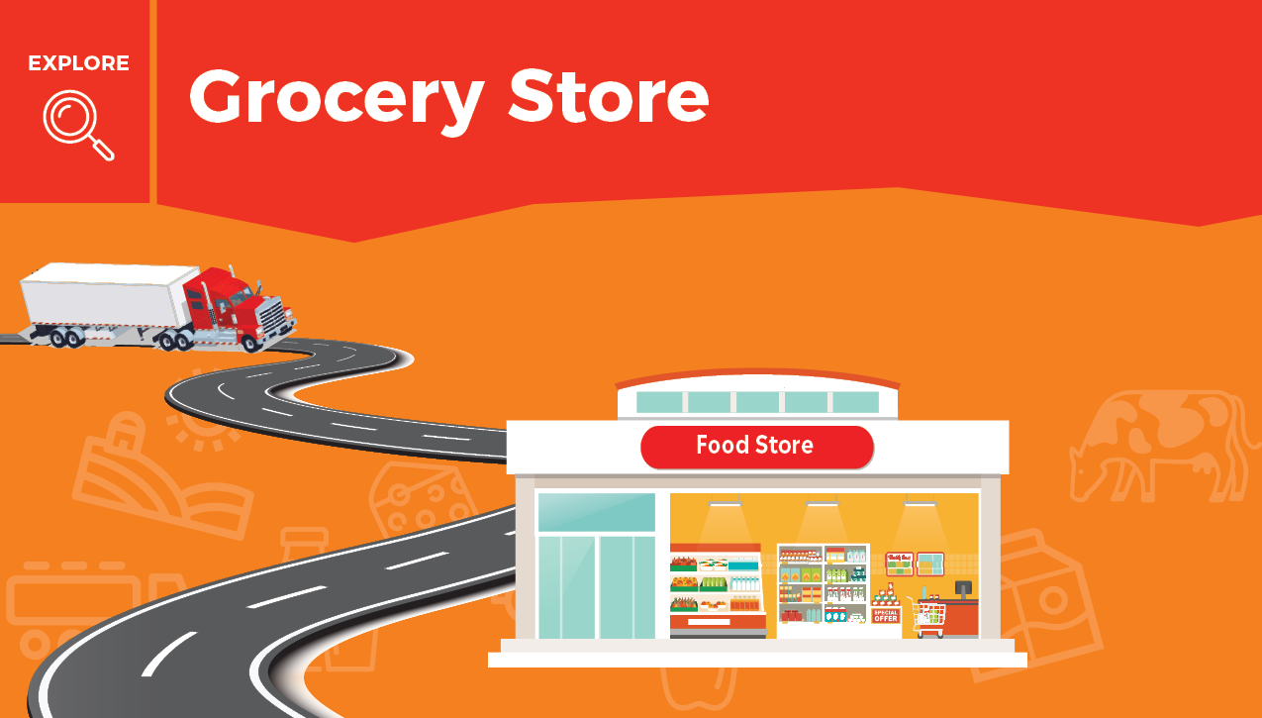

Milk arrives at the grocery store or your school cafeteria quickly, just 2 days after it leaves the farm.

Slide 11
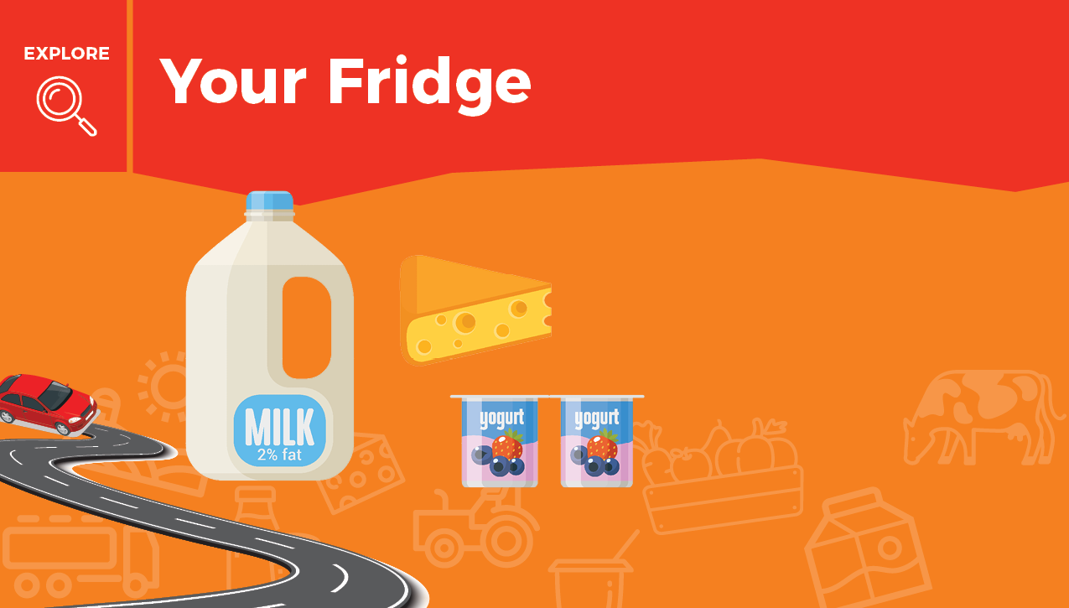

A variety of milk and dairy foods help your body learn, play, and grow.

Slide 12

Which dairy foods are your favorites?
There are many kinds and flavors of milk, yogurt, and cheese.
Type some of your favorites below!

Slide 13


Slide 14
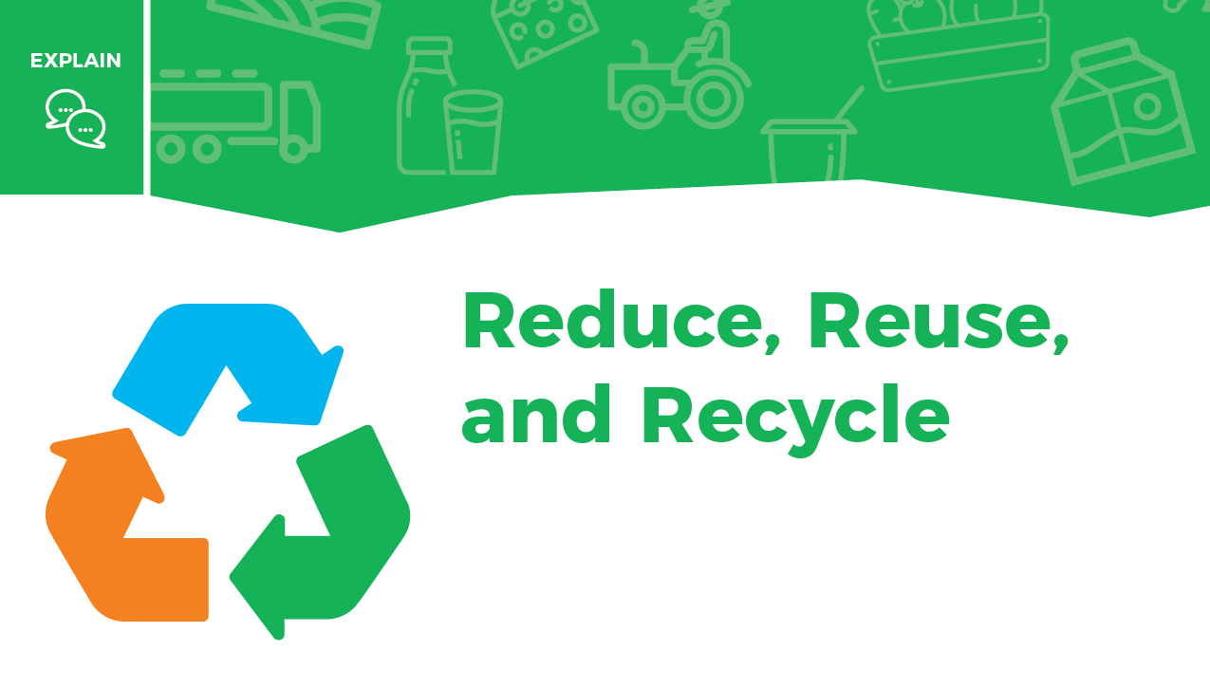
Did you know that dairy farmers and the cows they care for are very good recyclers?

Slide 15
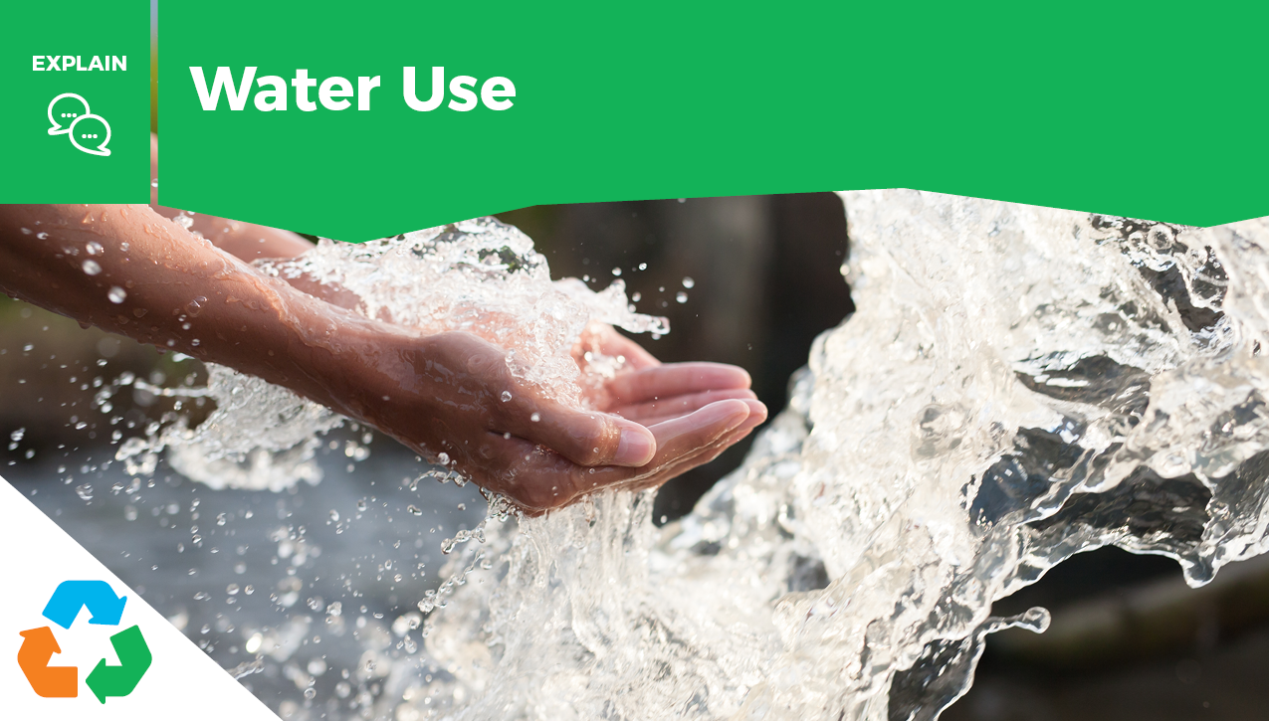
Farmers recycle and reuse water 3–5 times on the dairy farm. Water is used to clean the milking parlor, barn alleys, and walkways. The same water is used to grow crops that feed the cows.

Slide 16
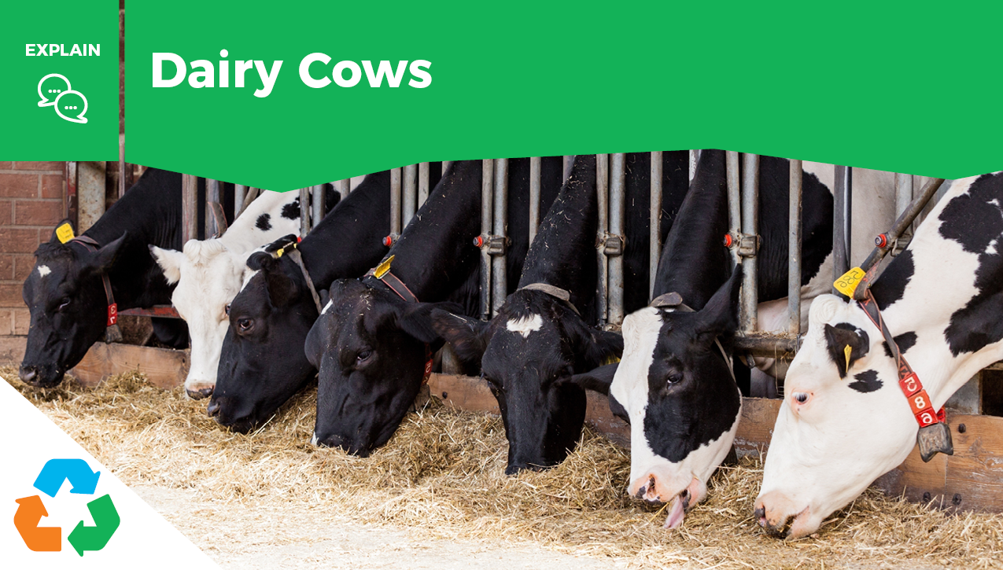
Having a stomach with 4 compartments means cows can eat food that people cannot.
A cow’s diet is 75% food by-products that humans cannot eat, like citrus pulp, cottonseed, or almond hulls. This also reduces the waste that goes into landfills.

Slide 17
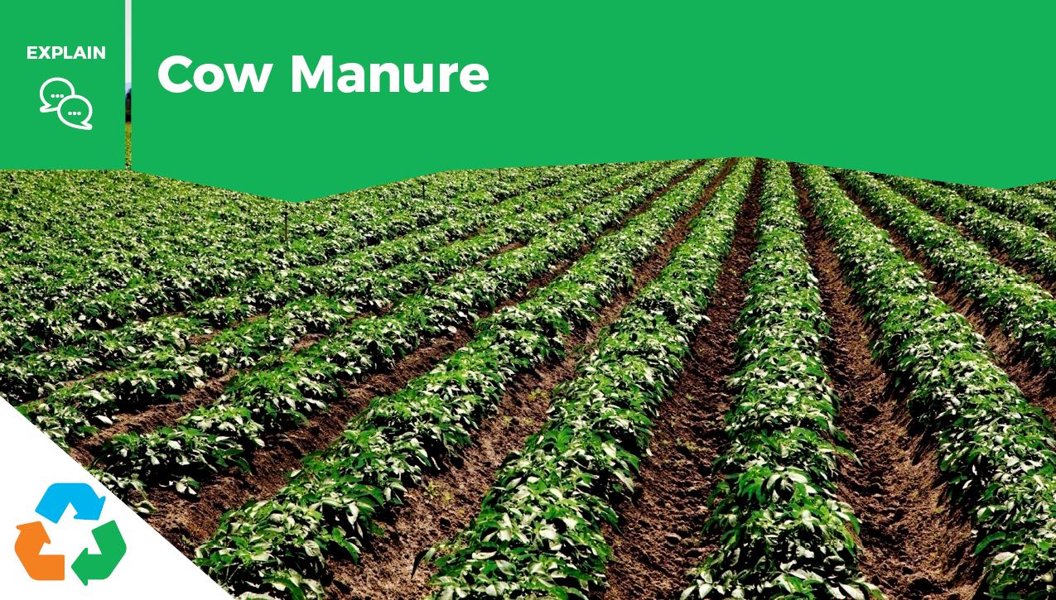
Manure from cows can be reused in many ways:
As fertilizer for crops
As energy to power, like electricity, for the dairy or nearby homes
As fuel for cars and trucks

Slide 18
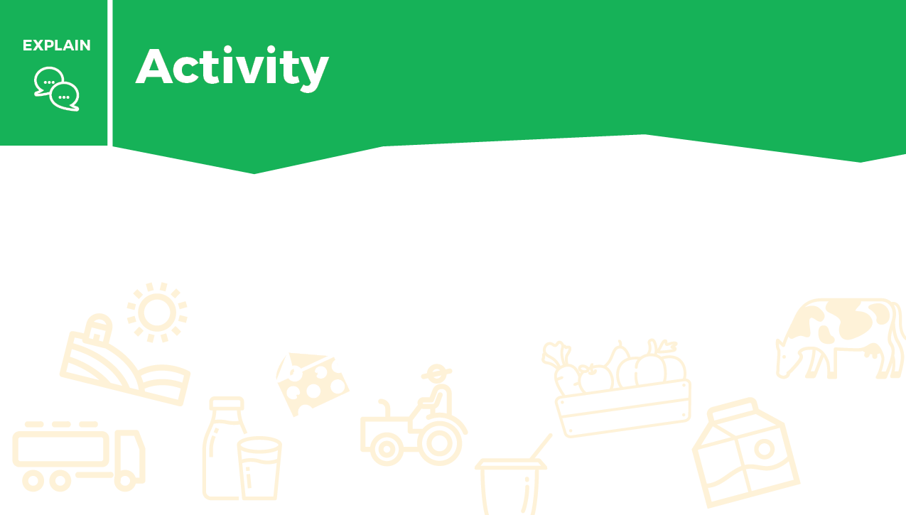
Write about the most interesting way that cows and dairy farmers reduce, recycle, or reuse. Use the box to complete this activity.

Slide 19
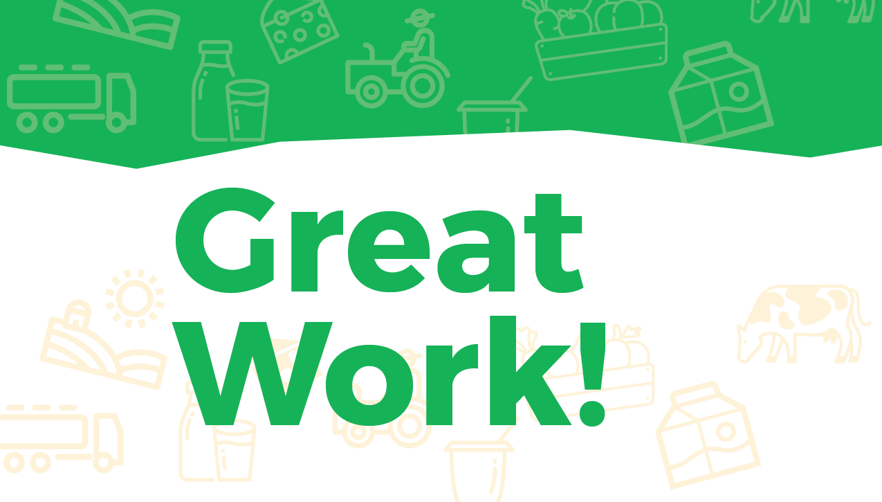

Slide 20

Many people work in our food system to make sure that you and your family have safe and nutritious food.

Slide 21

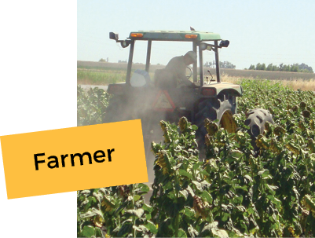
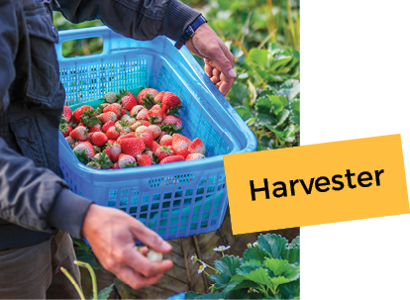
“I work on a farm growing the crops.”
“I pick the fruits and vegetables in the orchards or the fields.”

Slide 22


“I put the food on the grocery store shelves.”
“We plan and cook meals for our family.”

Slide 23

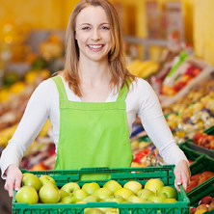
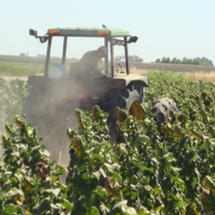

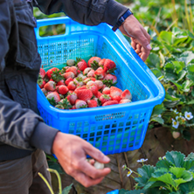
Drag each image to the correct box.
Grocery
Store
Clerk
Farmer
Harvester
Family
Cooks

Slide 24
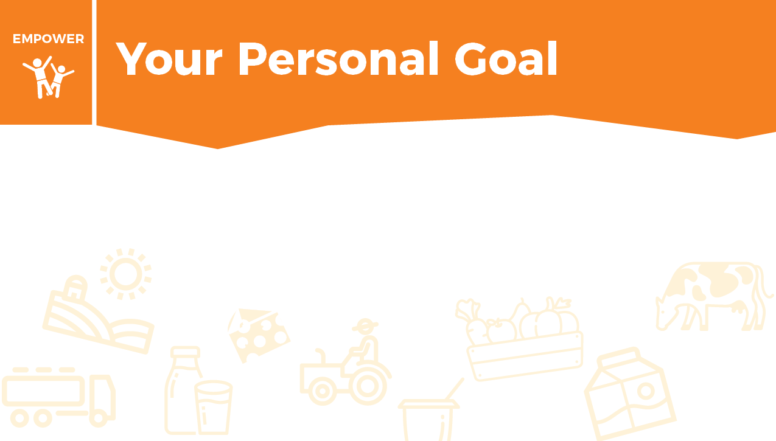
How can you show gratitude to the many people involved in bringing you delicious and safe food? Write your personal goal below. Who will you thank? What will you do?

Slide 25


Check the box when you complete each exercise.
California is an agriculture-rich state. Foods from each of the 5 food groups are produced across the state.
Dairy: Dairy foods come from cows. Cows move slowly in the pasture. Mimic a cow’s movement by walking with your hands and feet for 2 minutes. Make sure your knees do not touch the ground. Try to move as slowly as possible.
Vegetables: Vegetables grow in the ground. Hold a deep squat for 2 minutes and mimic pulling carrots from the ground.
Fruits: A majority of fruits grow on trees. Hold a tree pose for 1 minute on each side. See which side you can hold longer.

Slide 26

Check the box when you complete each exercise.
Grains: Grains come from plants like wheat, barley, and oats. Your body digests grains and makes glucose, which gives you energy. Perform as many burpees as you can for 2 minutes. Burpees require a lot of energy because they are a whole-body movement.
Protein: Animal protein comes from animals like cows, pigs, or chickens. Plant protein comes from plant parts like beans, nuts, and seeds. Find 1 or 2 big, heavy books and walk around for 2 minutes carrying those books with only your fingers touching them. Try not to drop the books. If you do, pick them up quickly and continue.

Slide 27


Slide 28
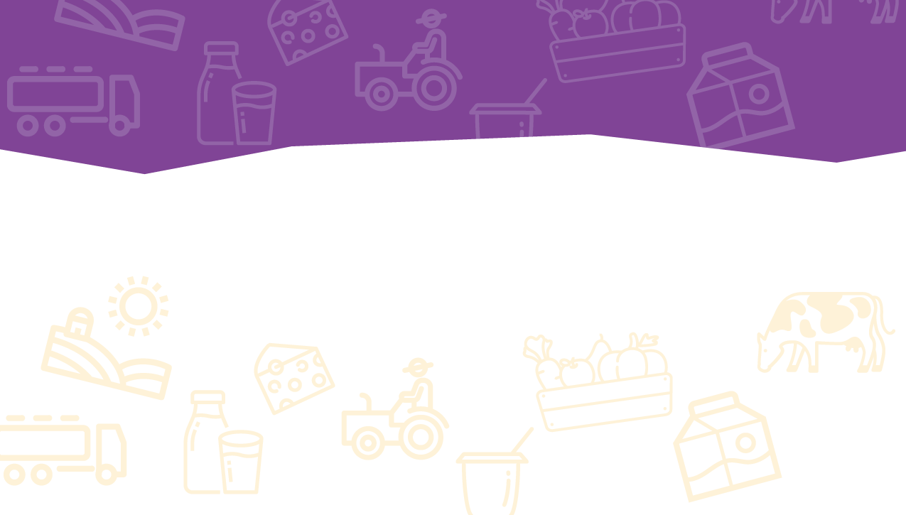
Take this short Knowledge Check to share what you learned.

