Slide 1
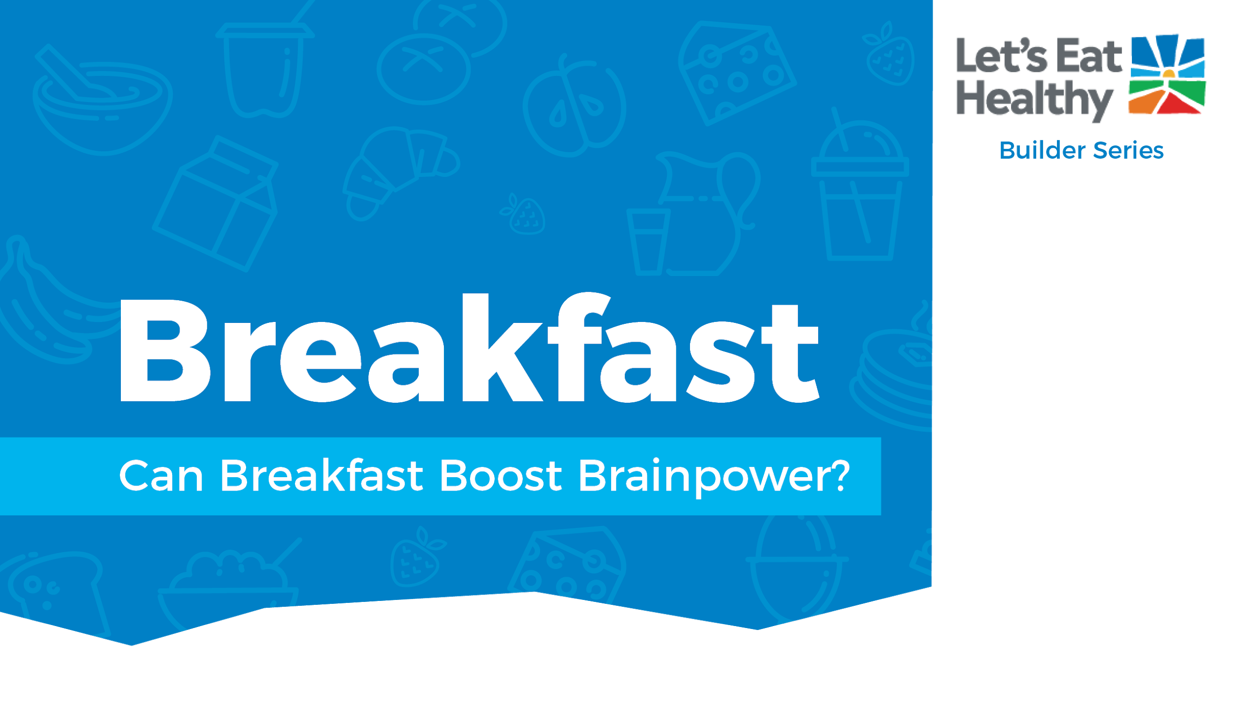

Upload this file to your class’s Google or Virtual Classroom if asked by your instructor.

Slide 2

What foods can you choose to make a healthy breakfast?
Why is breakfast important?

Slide 3






Slide 4




Mark done in the box when finished reading.
Breakfast is the first fuel of the day. Starting the day with breakfast is a healthy habit that helps you learn, play, and grow.
It is important to eat breakfast every day. Choosing foods from 3 different food groups (Dairy, Vegetables, Fruits, Grains, and Protein) helps give you energy and feel full longer.

Slide 5

Mark done in the box when finished reading.
Most schools offer a nutritious breakfast that includes foods from 3 of the 5 food groups.
The breakfast pictured here is another example of a healthy, balanced breakfast. Can you name the foods and what food group they belong to? (Hint: This breakfast includes 4 of the five good groups).

Slide 6


Check out this video!
Foods from at least 3 of the 5 food groups build a healthy breakfast pattern.
Breakfast is important because it provides the first fuel of the day. It gives you energy to learn and play.

Slide 7


Slide 8

Breakfast foods give you fuel, or energy, to start you off ready to learn and play. The pictures show what having energy looks like!

Slide 9

What can you do to eat breakfast every day? You can eat breakfast at home or at school. You can help your family make breakfast. Or maybe you can help shop for favorite breakfast foods at the store.
Write about why you think breakfast is important to eat every morning.

Slide 10


Slide 11
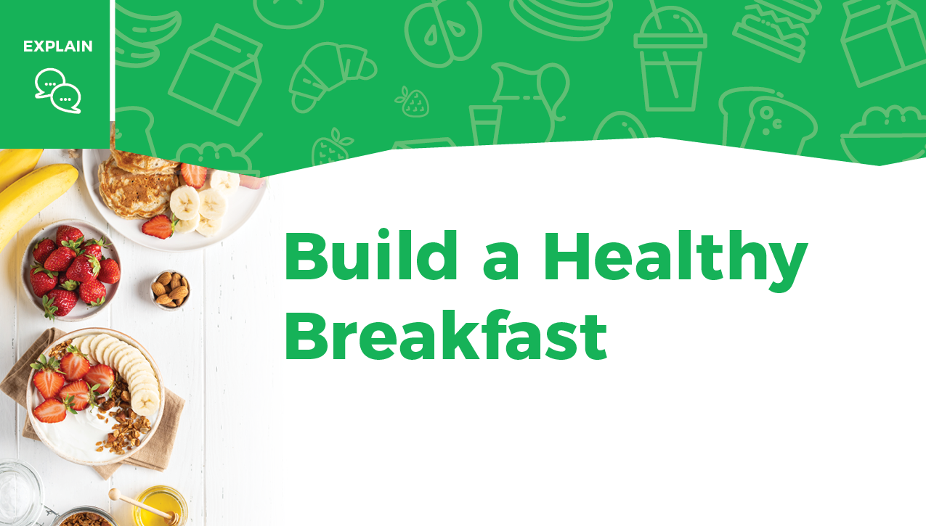
Many foods can be combined to build a healthy breakfast.

Slide 12
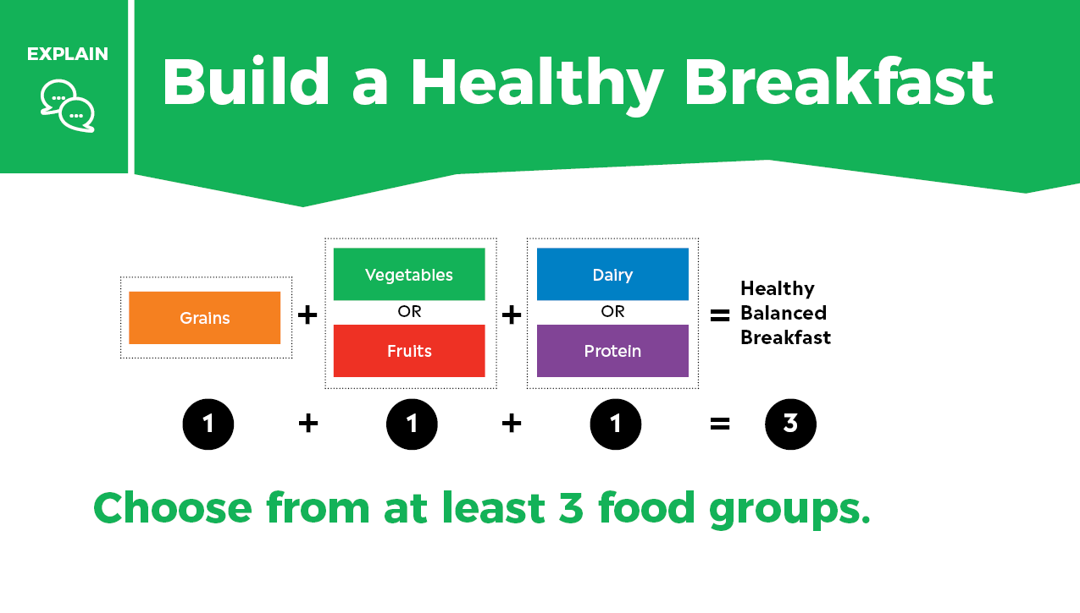

Slide 13
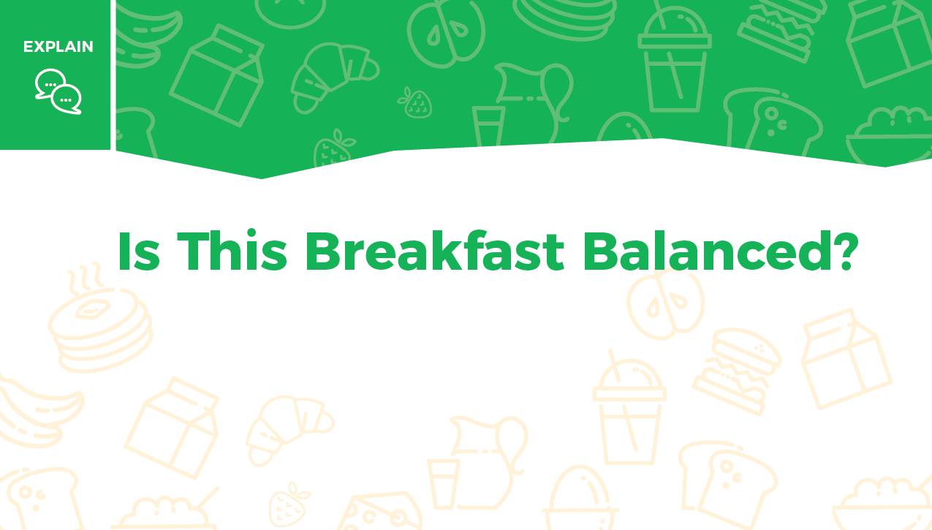
Look at the 3 breakfasts pictured on the next 3 slides.
Type the food groups you see included in each breakfast picture.

Slide 14
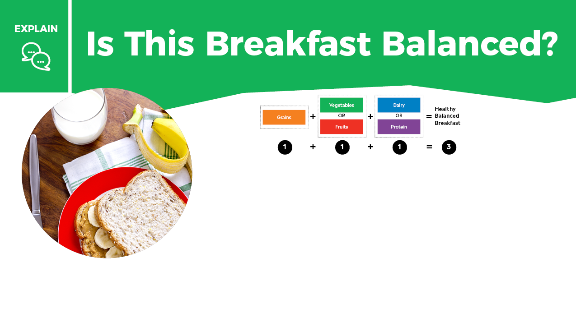

What food groups are included in the breakfast?
Whole-grain bread with peanut butter, banana and glass of milk
Is this
breakfast
balanced?

Slide 15
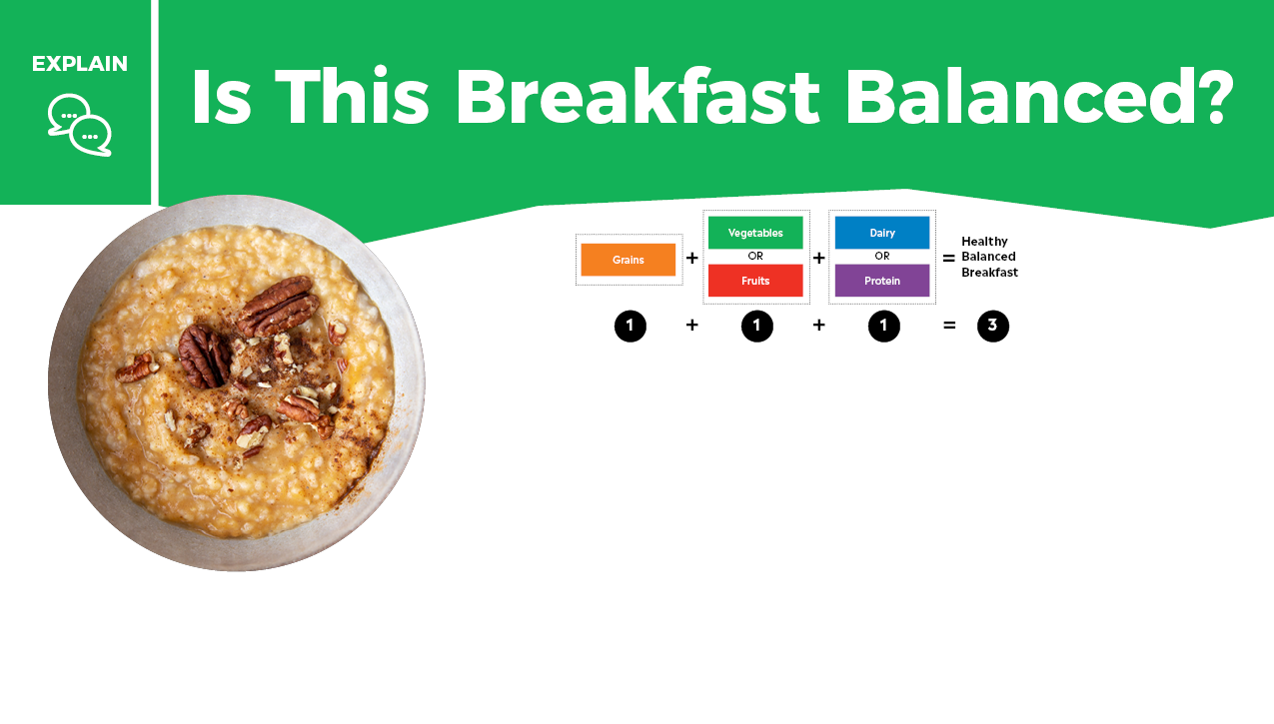
What food groups are included in the breakfast?
Oatmeal with nuts and water
Is this
breakfast
balanced?

Slide 16
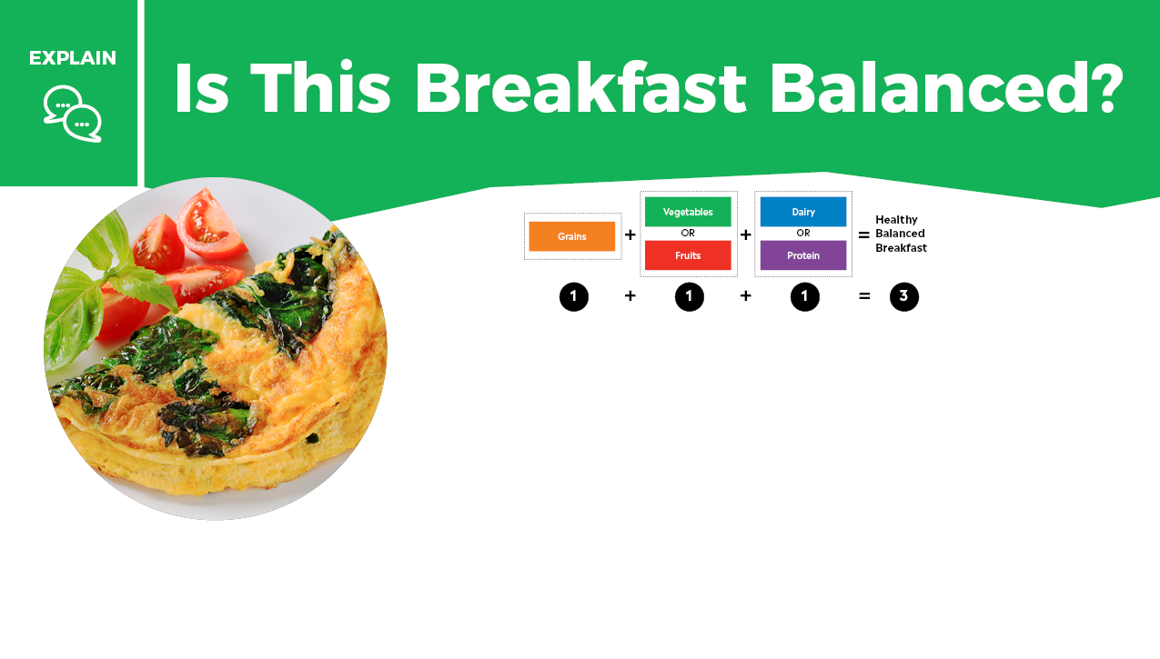
What food groups are included in the breakfast?
Vegetable and cheese omelet
Is this
breakfast
balanced?

Slide 17

Were there any breakfasts that were not balanced?
What food could you add to make it balanced?
What food group does that food belong to?

Slide 18


Slide 19



Instructions
On the next slide, list 3 foods from 3 different food groups that you would like to eat for your own breakfast.
Next to each food, write the name of the food group. Ask your teacher or a family member to help you locate your school breakfast menu online. This may give you some ideas, too.

Slide 20

Food Group
Food
Use the 3 out of 5 rule by using grains + fruit or vegetable + dairy or protein.

Slide 21
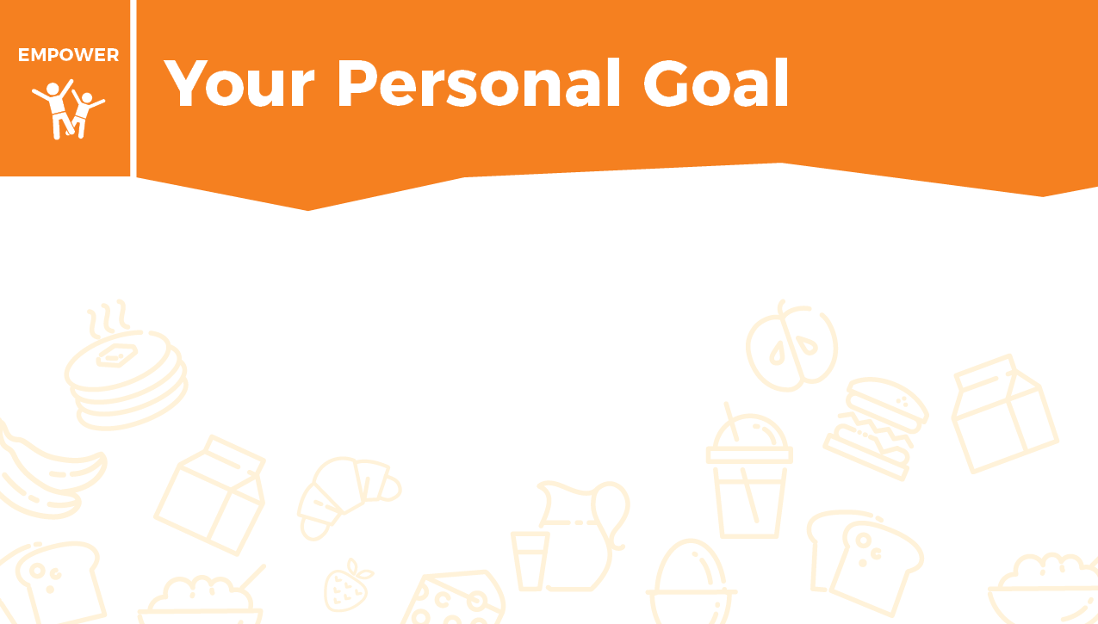
Now it is time to turn your plan into action. Share this menu with your family. Offer to help prepare this breakfast for everyone to enjoy!
At home you can help with breakfast by:

Slide 22


Think of a complete breakfast that includes 3 out of 5 food groups. The 5 food groups help your body learn, play, and grow.
Which food group makes up the biggest part of your breakfast? Do 15 repetitions of that exercise without stopping. For your second food, do 10 repetitions. For the last food, do 5 repetitions. Repeat 3 times.
Dairy helps build strong bones and teeth = squat jumps
Vegetables support healthy skin and eyes = plank
Fruits aid in healing = downward-facing dog to snake pose
Grains give the body energy = burpees
Protein builds strong muscles = push-ups
Watch how to do the exercises!

Slide 23

Example:
A complete breakfast could be peanut butter toast with milk.
Milk = Dairy: Do 15 squat jumps.
Peanut Butter = Protein: Do 10 push-ups.
Toast = Grains: Do 5 burpees.
Repeat 3 times.

Slide 24


Check out these tasty breakfast recipes.

Slide 25
Take this short Knowledge Check to share what you learned.

