Slide 1
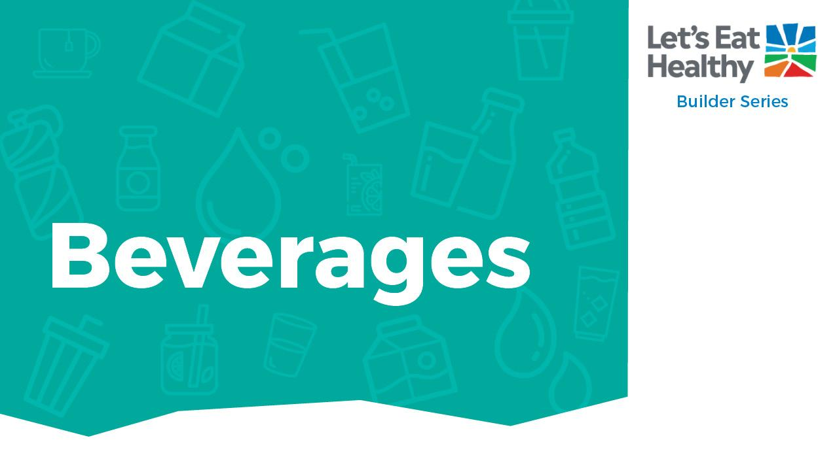


Slide 2
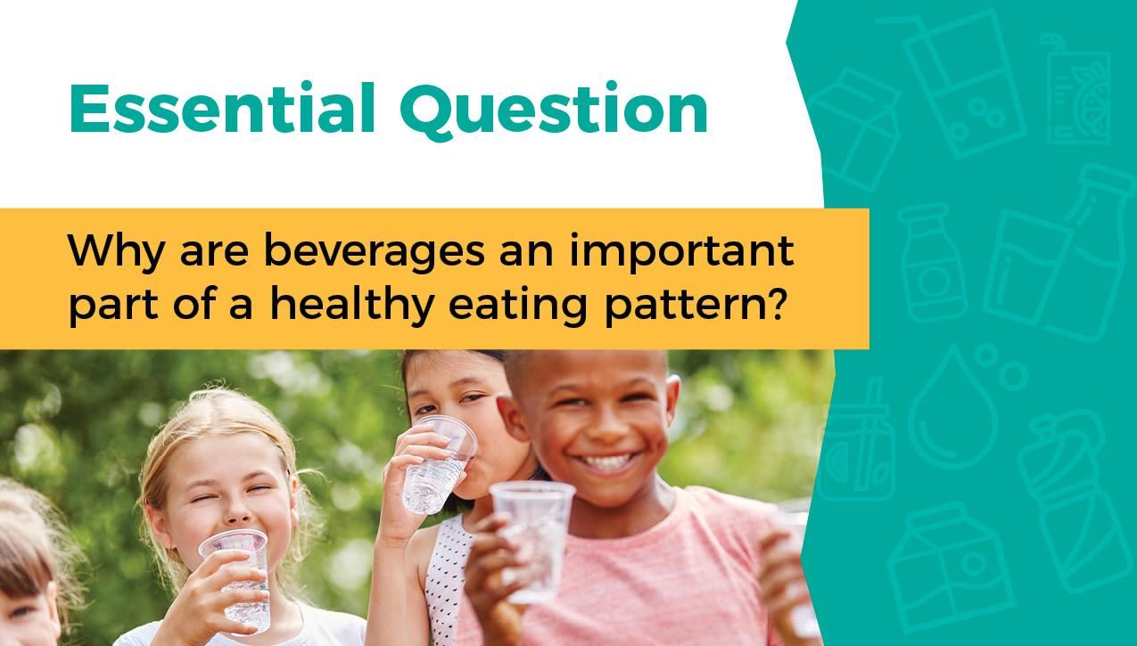

Slide 3
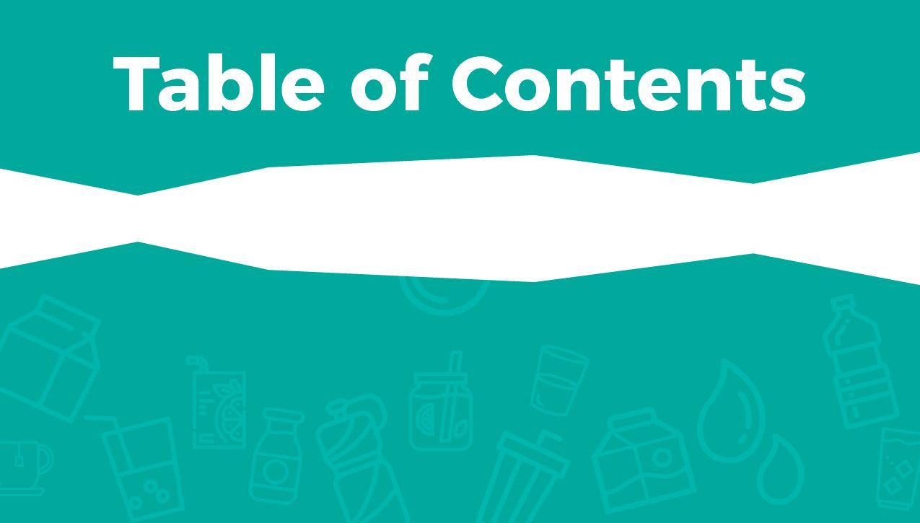





Slide 4




Mark done in the box when finished reading.
Water, milk, and 100% juice are the healthiest beverage choices. They help your body learn, play, and grow.
Milk is a healthy and nutritious beverage. It has important nutrients like calcium, protein, vitamin A, vitamin D, and more. These nutrients and others work together to help your body grow healthfully, develop strong bones, and lean muscle.
Whole fruits and vegetables give you many nutrients, but drinking 100% fruit juice can give you some of the same health benefits. Limit juice to 6 ounces (less than 1 cup) each day to make room for water and milk.

Slide 5

Mark done in the box when finished reading.
There are many beverage choices, and beverages are just as important to your health as the food you eat. Water is a healthy beverage.
Water is important for good health. Water helps cool your body by producing sweat, and it helps digest food by moving it through your body. It also removes waste.

Slide 6
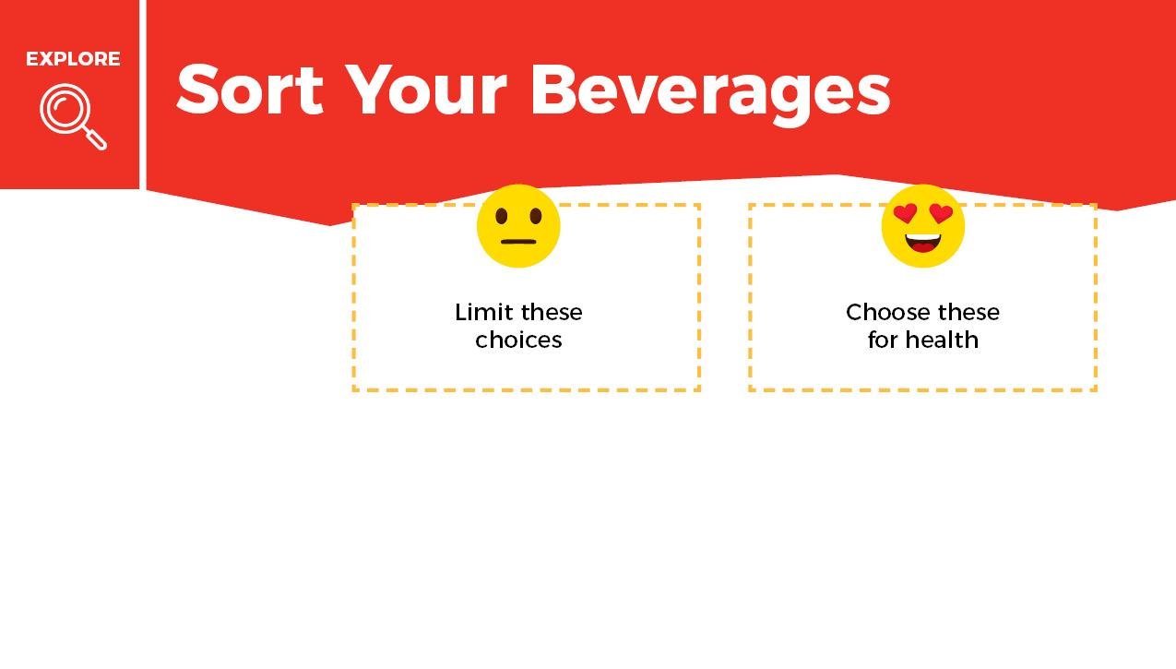

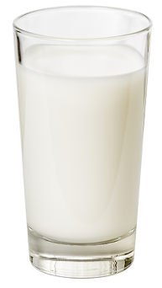
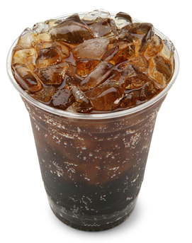
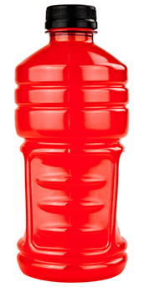
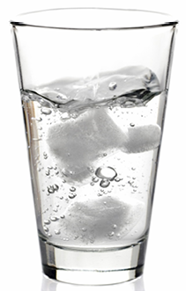
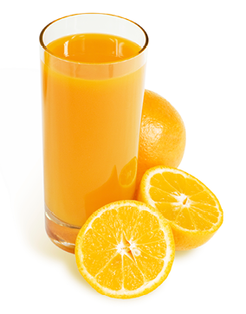
Sort the drinks into categories.
Choose more of the beverages that help your body.
Limit the beverages that do not help your body.
When you are finished put a check mark in the done box.
Milk
Soft drink
Sports drink
Water
Orange Juce

Slide 7
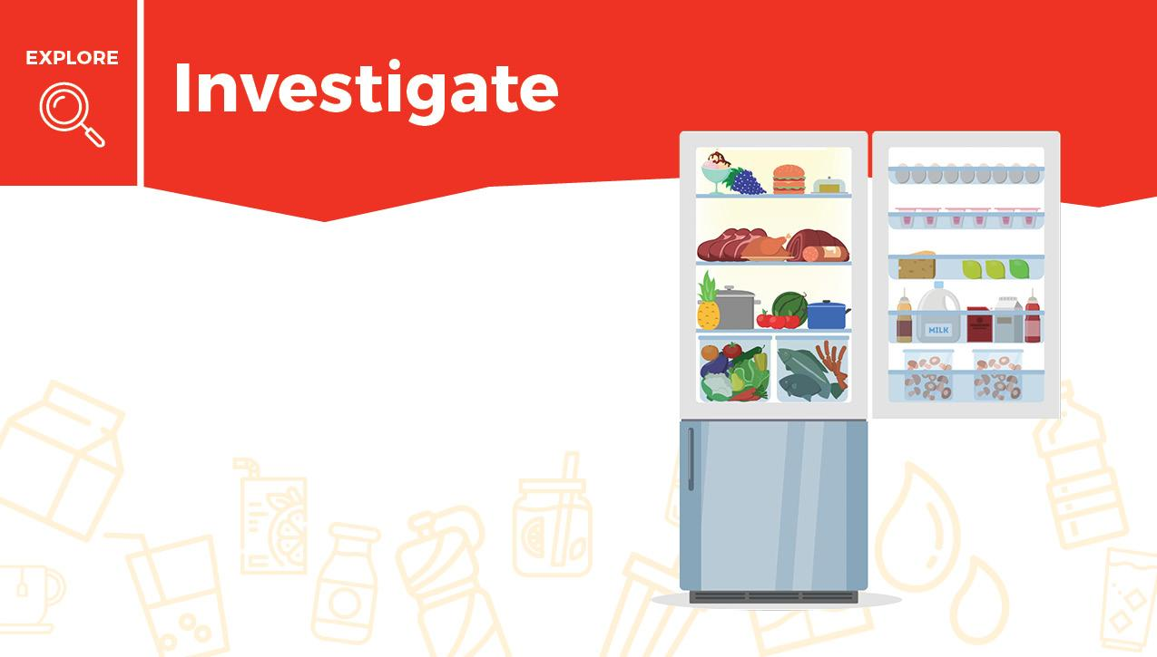
Think about what you drink each day. Complete the chart on the next slide using the information you learned about beverages.
Tip: Check your refrigerator or pantry to see what beverage choices you can make.

Slide 8


What do you drink? | How many times a week do you drink this? | Drag an emoji if your choice is helping your body.

Slide 9
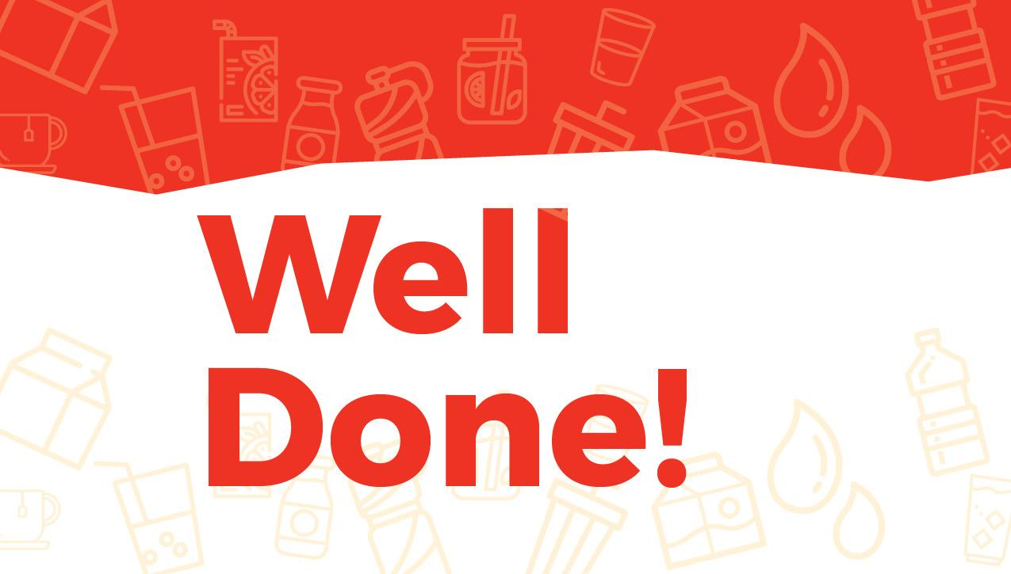

Slide 10

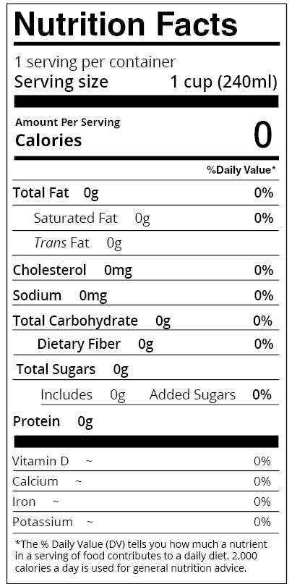
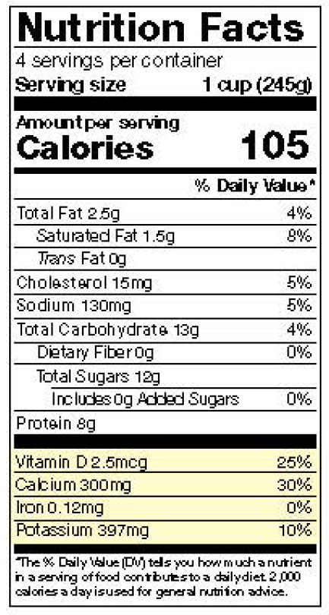
The label gives you clues about a drink and its health benefits.
Water has a lot of zeros on the label. That doesn’t mean it is not important. It is needed every day for your body to work properly!
Milk has nutrients to help build a healthy body and give you other health benefits.

Slide 11
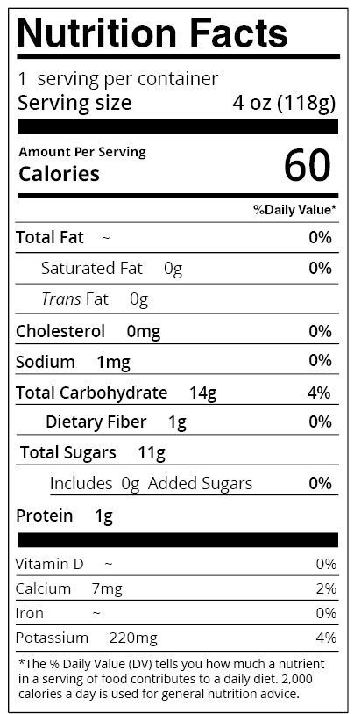
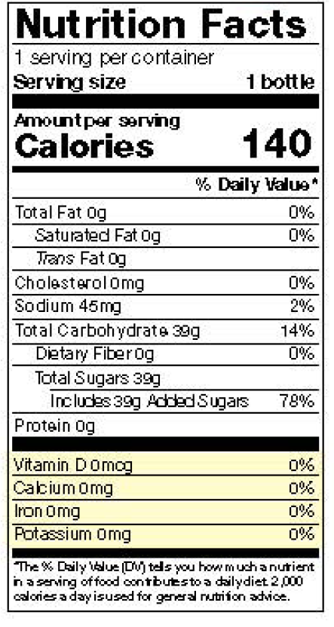
Drinking small amounts of 100% juice can give you some of the important nutrients found in whole fruits and vegetables, but eating whole fruits and vegetables is the best choice.
A soft drink has added sugar and does not give your body vitamins or health benefits.

Slide 12
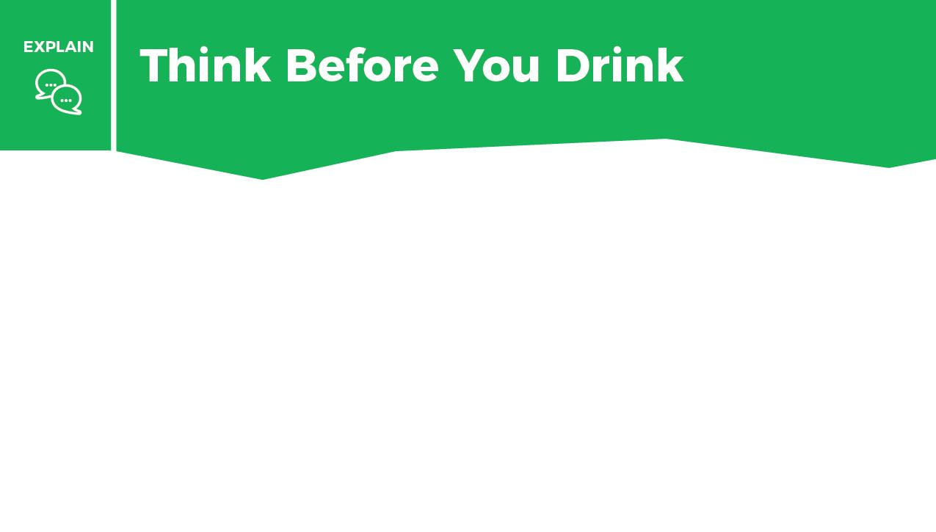


Imagine you made these drink choices today.
1. Drag the “keep” button if the drink provides you health benefits.
2. Drag the “swap” button if you would swap it for a better choice.
3. In the bottom box, write what you would swap it for.

Slide 13
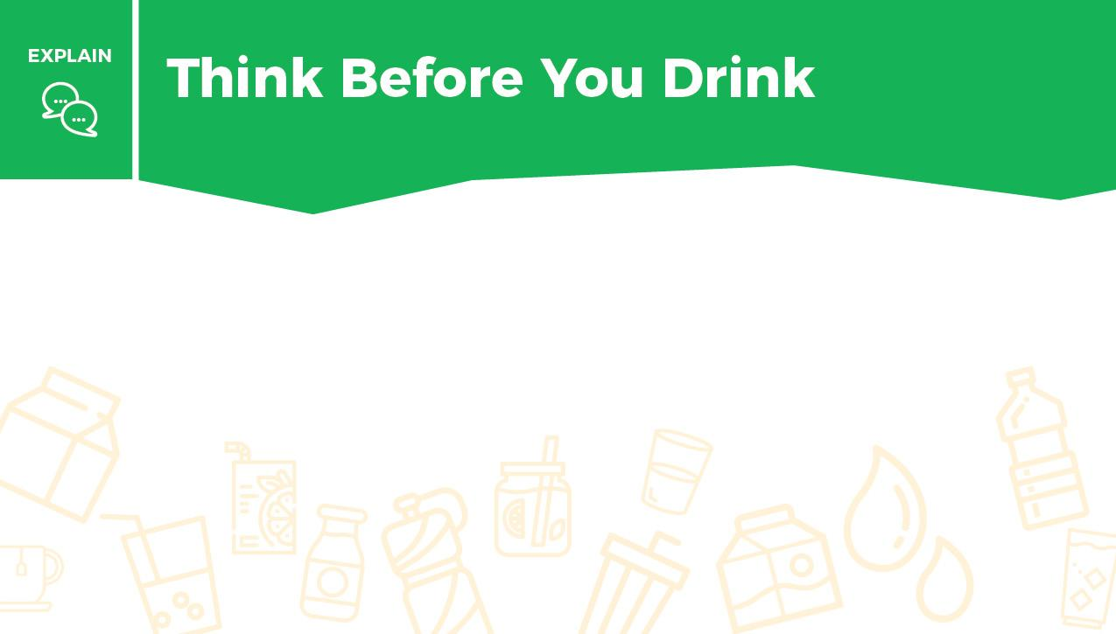
Write which beverage you will choose to help your body hydrate and stay healthy. Explain your choice.

Slide 14


Slide 15
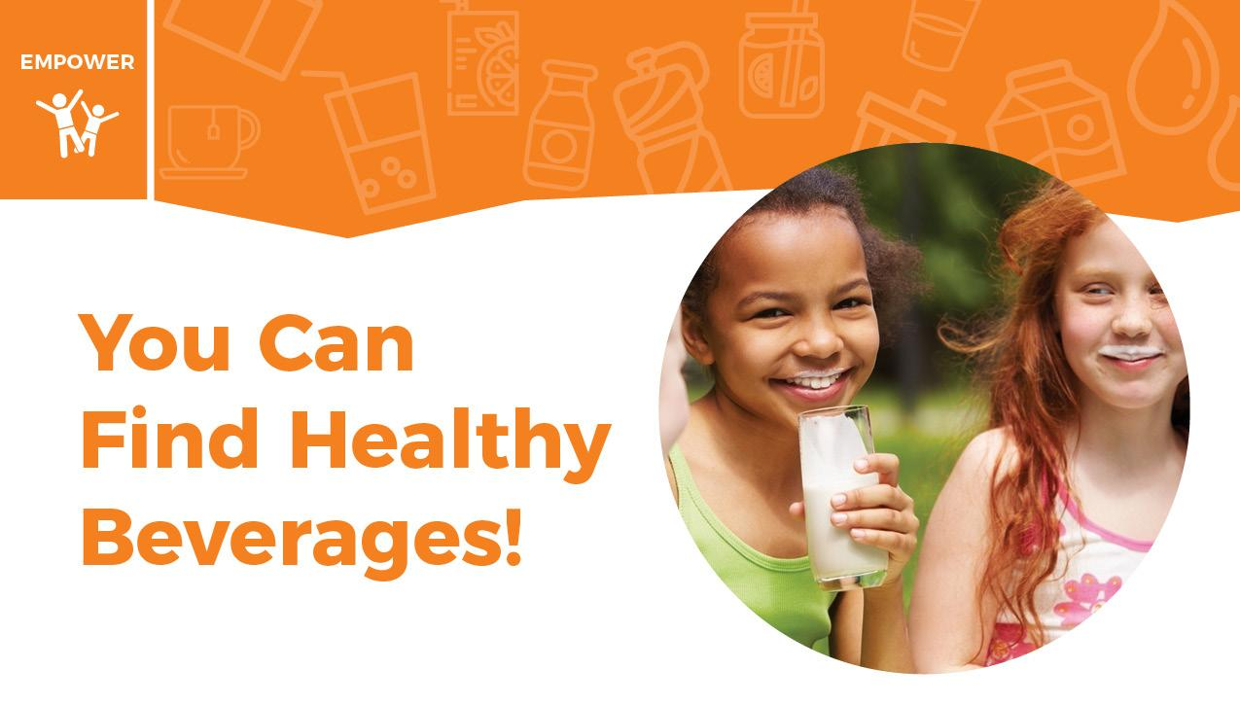

Slide 16
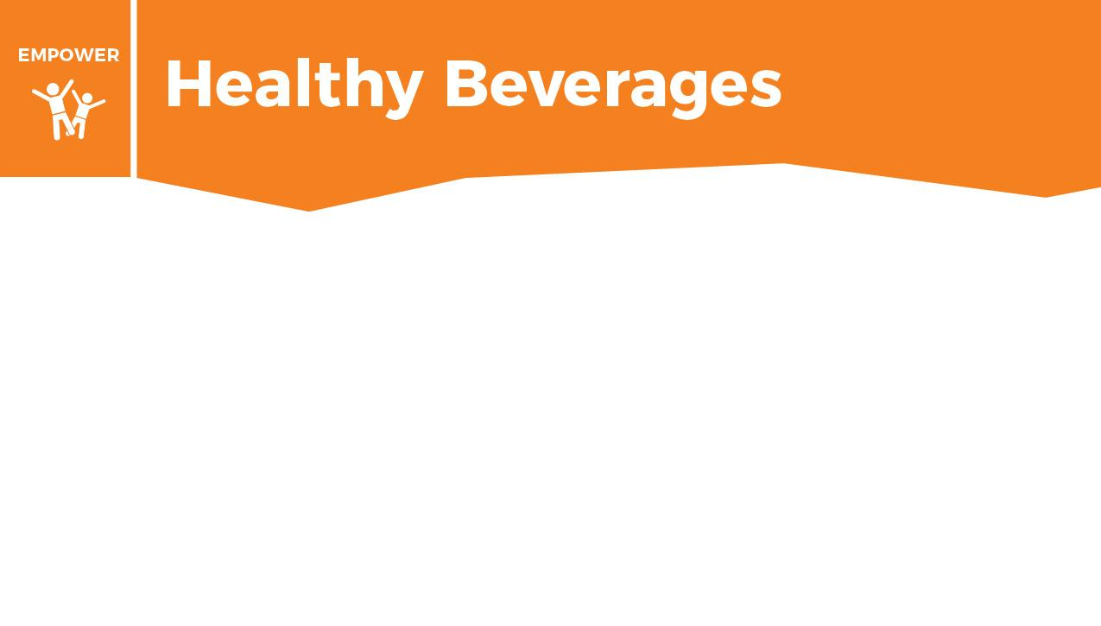
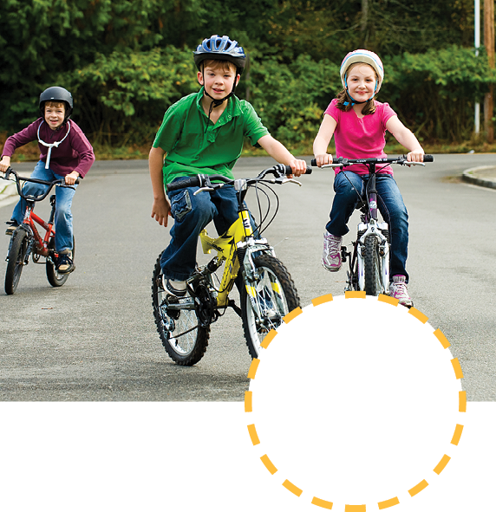


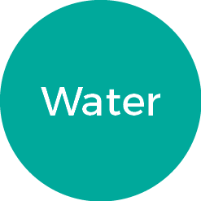

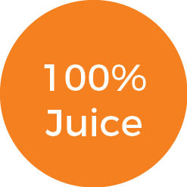
Choose which healthy beverage you will have during each activity by dragging the word next to the picture.
When you are finished put a check mark in the done box.

Slide 17

1. Reflect: What do you do well with your beverage choices?
2. Write a goal that will help you make more healthy beverage choices. You can use this sentence frame: “I will drink more ____ and I will drink less _____.”

Slide 18


What was the last beverage you drank?
If it was a drink with added sugar and no nutrients, like soda or an energy drink, sprint 15 yards (15 giant steps), 10 times without stopping.
If it was milk or water, do a slow jog for 15 yards, 10 times without stopping.
Think about what made you more tired: sprints or jogging? Sprints show you how drinks with high amounts of sugar and no other nutrients go through your body. You may feel energetic at first, but then lose that energy fast.
With milk, your energy will last for a longer time, and you will have more energy throughout the day. Water will keep you hydrated and help you focus. Both beverages are healthy choices.

Slide 19


Slide 20
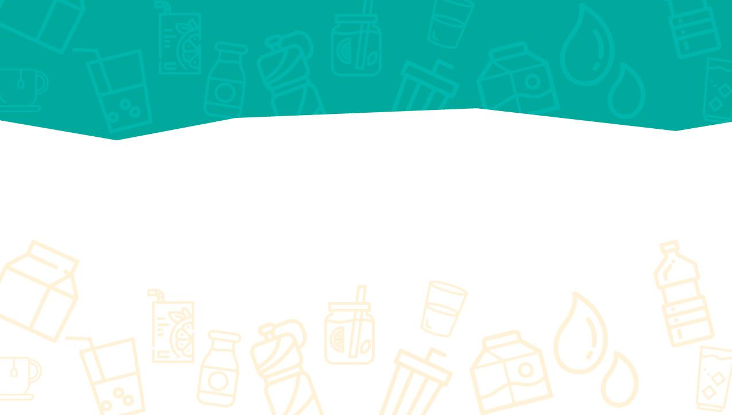
Take this short Knowledge Check to share what you learned.

